Slide 1
Cayuse IRB
Creating and Submitting additional submissions

Slide 2
How to use this tutorial
This tutorial is for researchers (PIs) who already have an approved IRB protocol and wish to change the study title and submit a renewal, modification, incident (adverse event) or closure.
If the protocol has not been reviewed and approved, then the researchers can submit a withdrawal type protocol. That process is similar to what is described here; the details are at the end of this tutorial.
In Cayuse, the first protocol is known as the “initial” study. It can also be called “de novo,” “new,” “draft” while it is being written and developed, and “under review” by the IRB (both the office and the Board members).
Before approval, PIs can withdraw their protocol from further review. Once approved, then the protocol can be amended/modified, renewed, or closed.
Use your keyboard’s left/right/up/down arrow (or your mouse/trackpad scroll or the spacebar) to move through the PowerPoint. Instructions are animated.

Slide 3
Before You Begin an IRB Protocol…
Make sure you have the following items ready*:
Supplemental documents in individual document files (i.e. informed consent form(s), authorization(s), recruitment documents, questionnaires, etc.). Files can be in various formats (PDFs, docx) however doc. (Microsoft Word) files are preferred.
Faculty advisor and co-PI(s) CITI training copy of certificate.
Ensure that you and your co-PI(s) have been “authenticated” with the IRB office. If you are unsure, contact the IRB office at irb@chapman.edu
*You do not have to finish the IRB protocol in one sitting. All information can be saved.

Slide 4
Log in to Cayuse:
https://chapman.cayuse424.com/

Slide 5
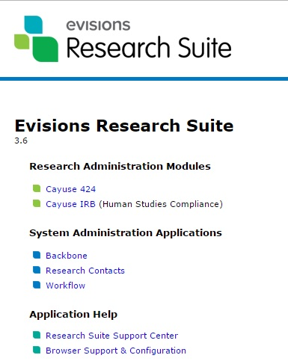
Once logged in, you’re first taken to this page. Click on “Cayuse IRB (Human Studies Compliance)”
Office of Research INTEGRITY

Slide 6
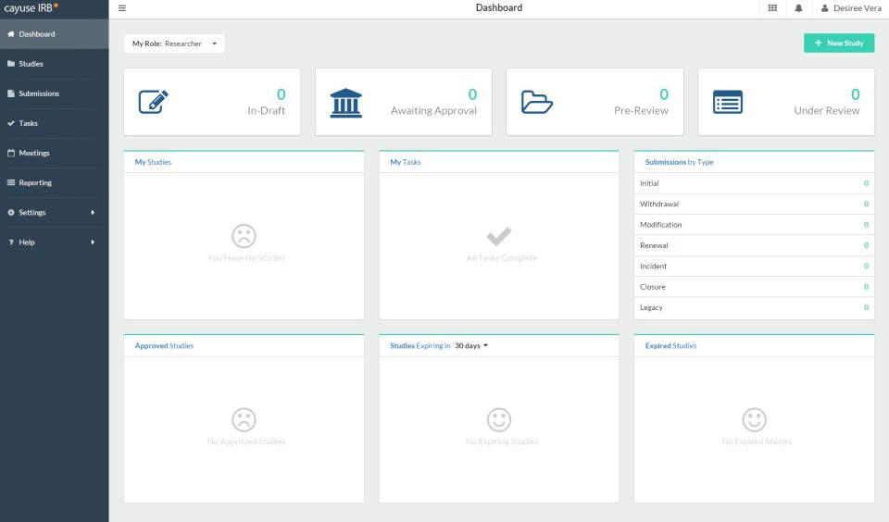
After clicking “Cayuse IRB”, you will be taken to your “Dashboard” where you can see all of your affiliated studies

Slide 7
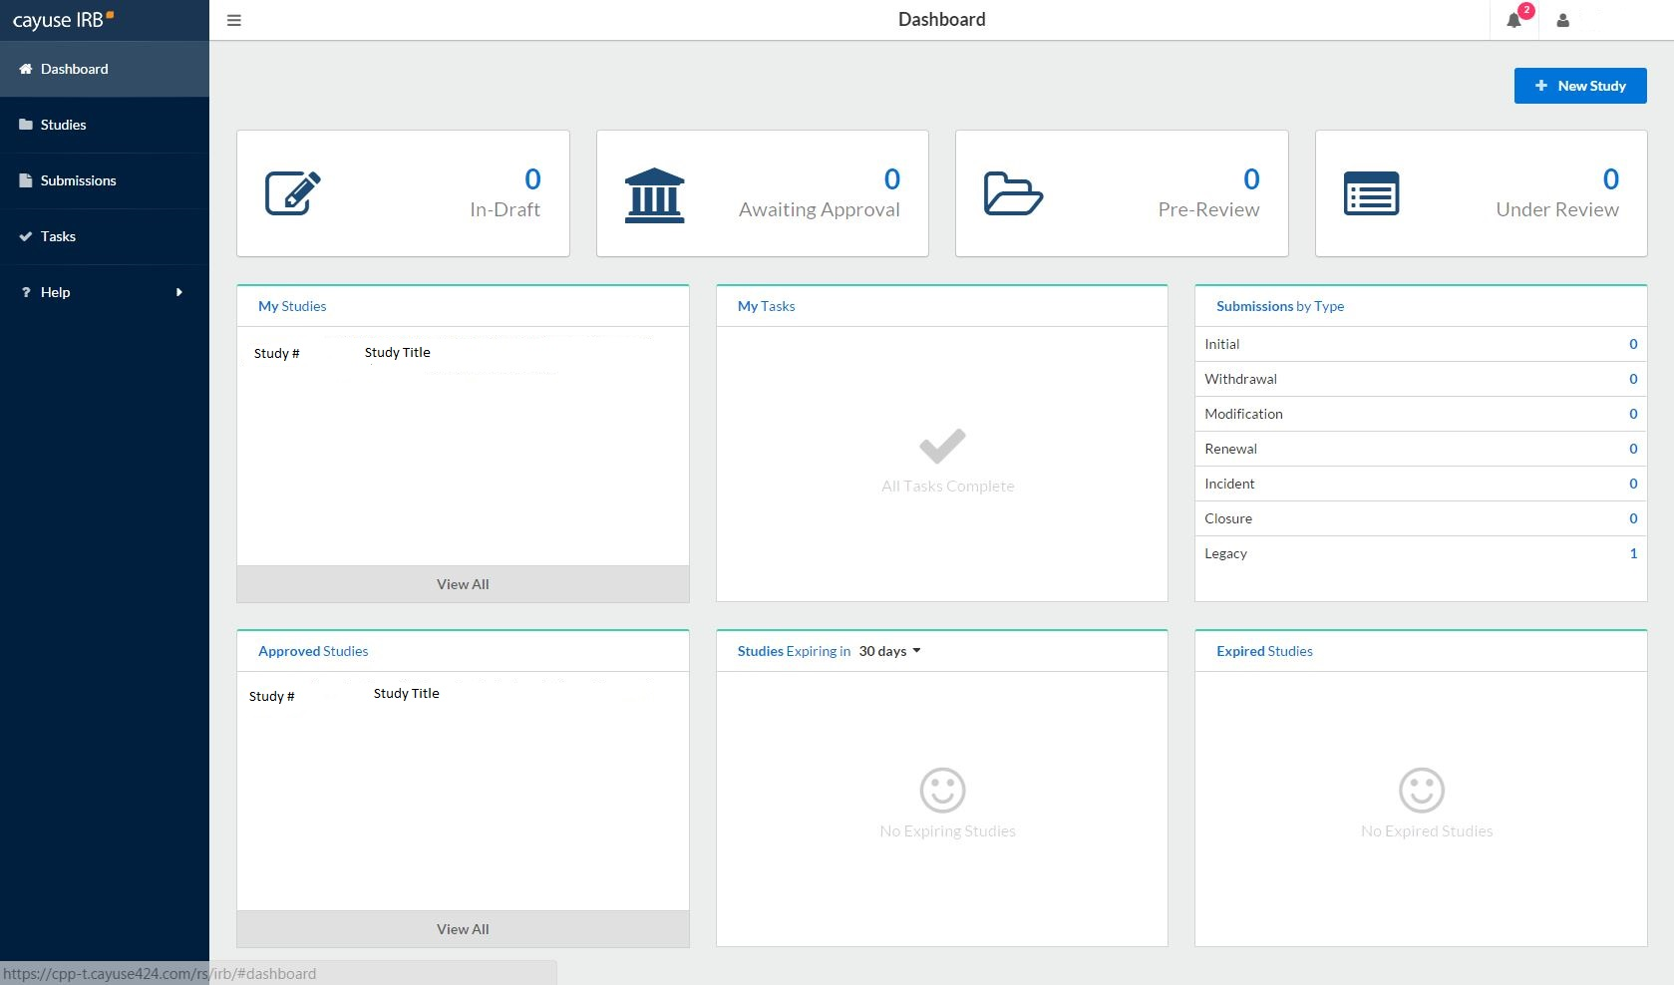
Select your study

Slide 8
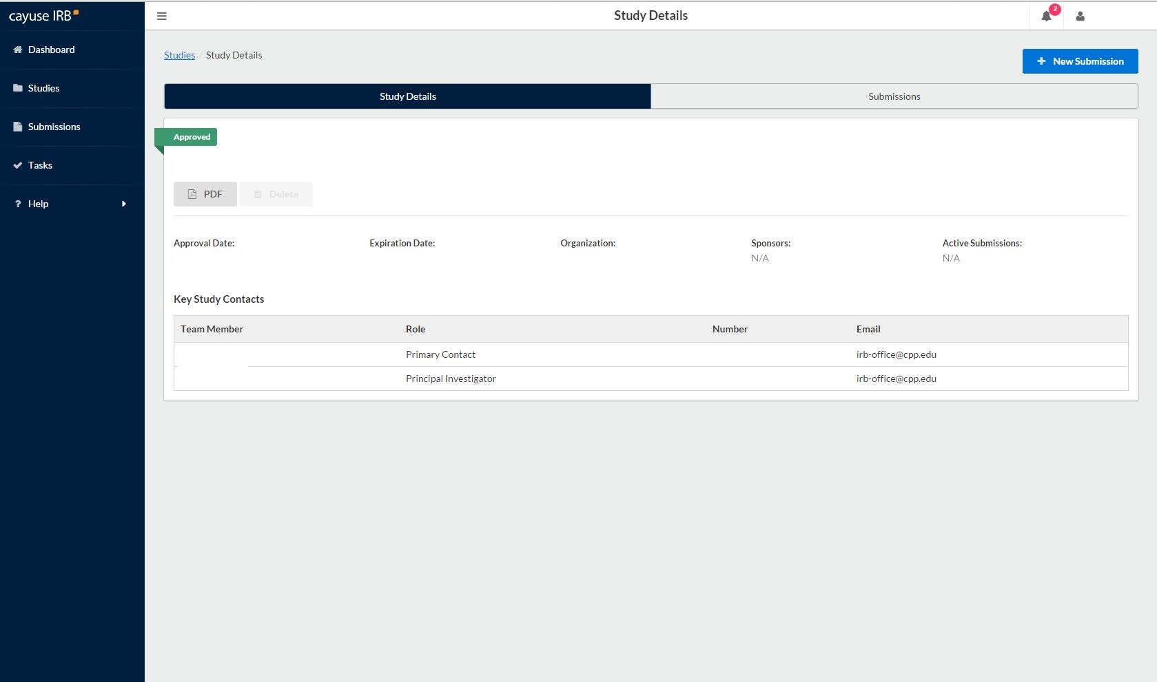
You’ll be taken to this page. Click on the blue button for “New Submission.”

Slide 9
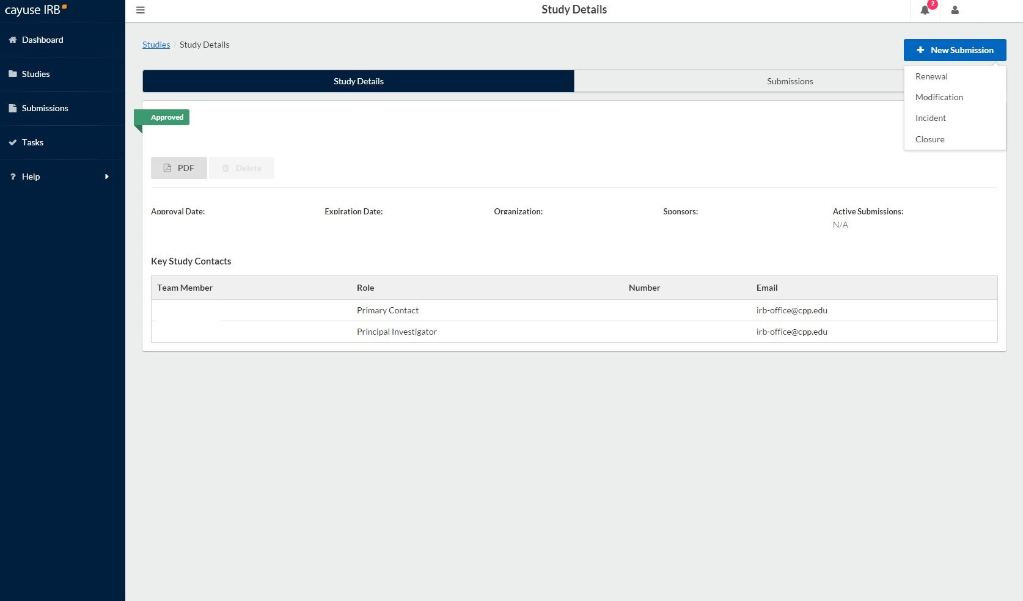
Select the type of submission you want to complete.
Renewal = extending the study for up to a year, before the approved protocol expires.
Modification = submitting a change or amendment to the protocol
Incident = reporting an adverse event or unanticipated problem
Closure = you are finished collecting data for the study

Slide 10
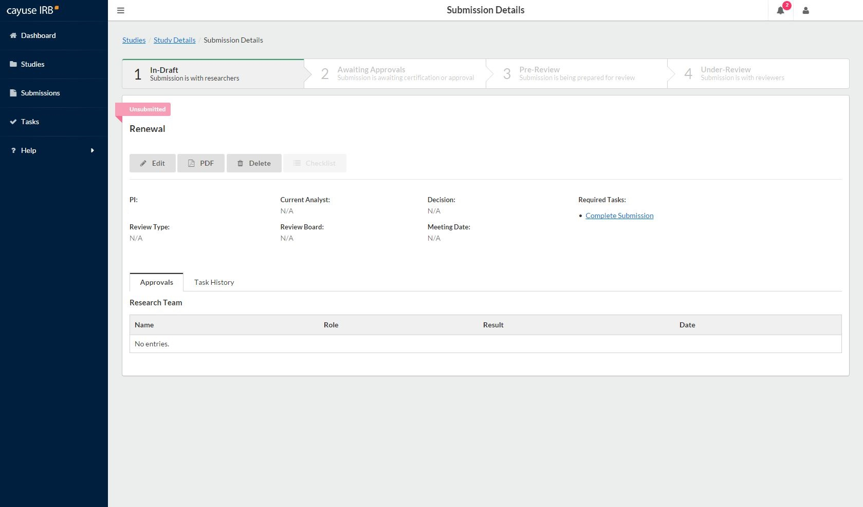
You’re taken to this page.
Click on “Edit” to provide details about the submission to the IRB.

Slide 11
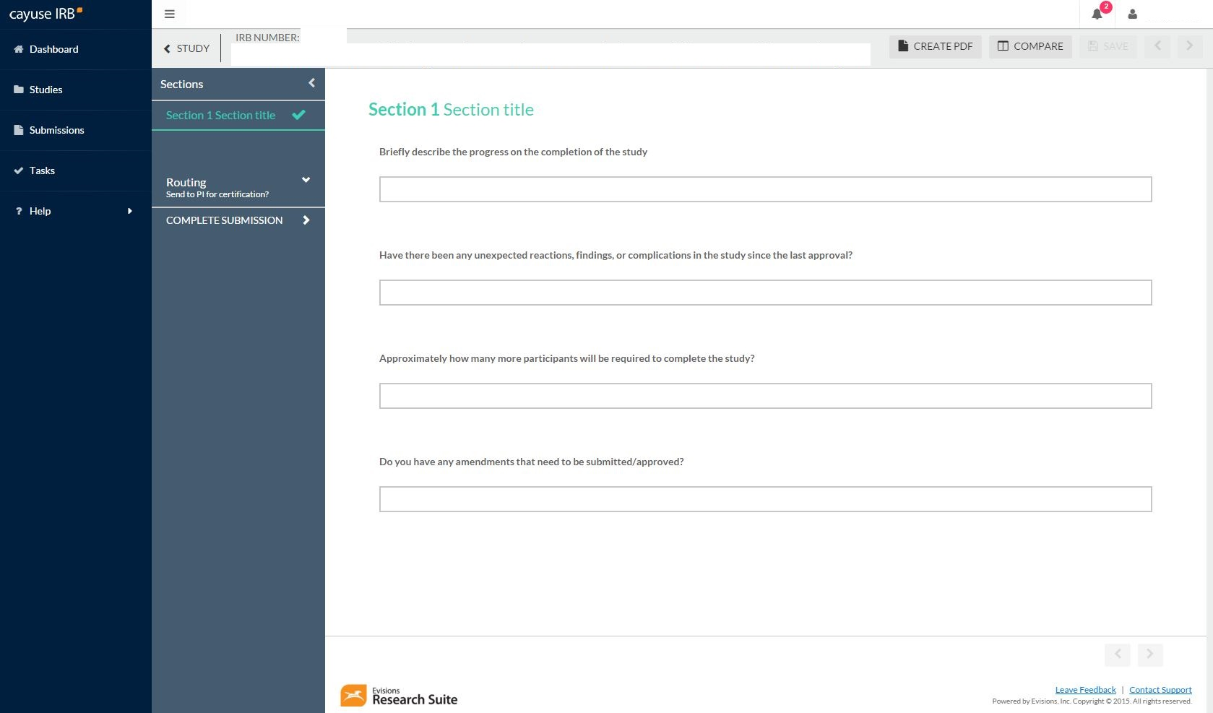
Fill out the “protocol.” Remember this is not the same as the initial protocol you did before.
When you are finished, click on “Complete Submission”.

Slide 12
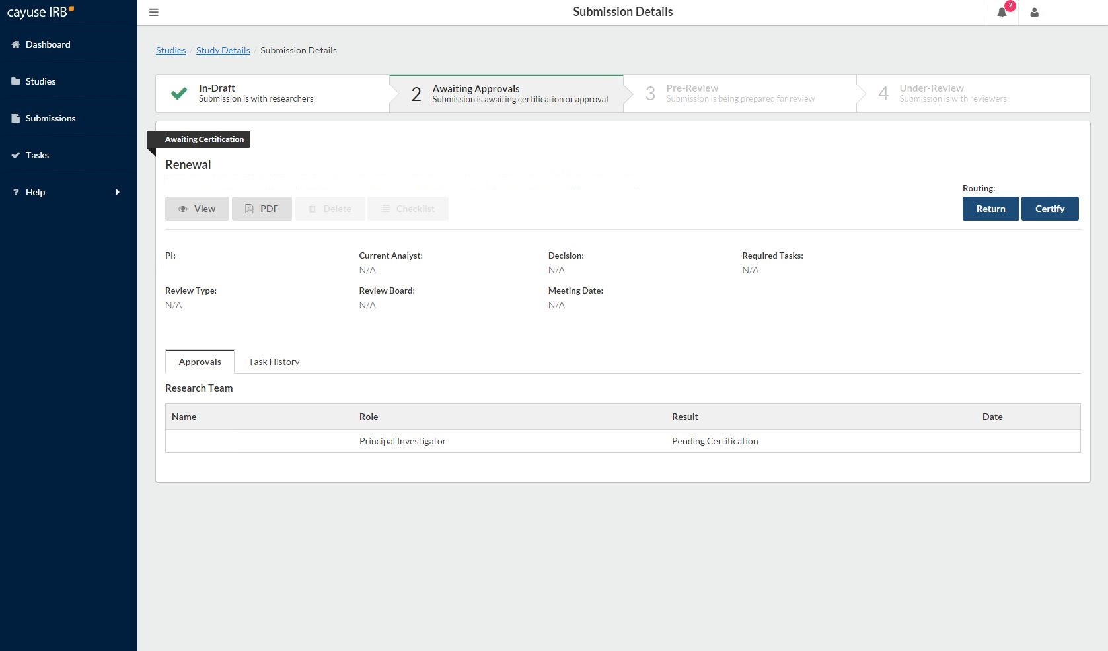
You’ll be redirected to this page. You will need to “Certify” in order to finalize the submission. Certification says you knowingly mean to take this action (to renew, amend/modify, or close).

Slide 13
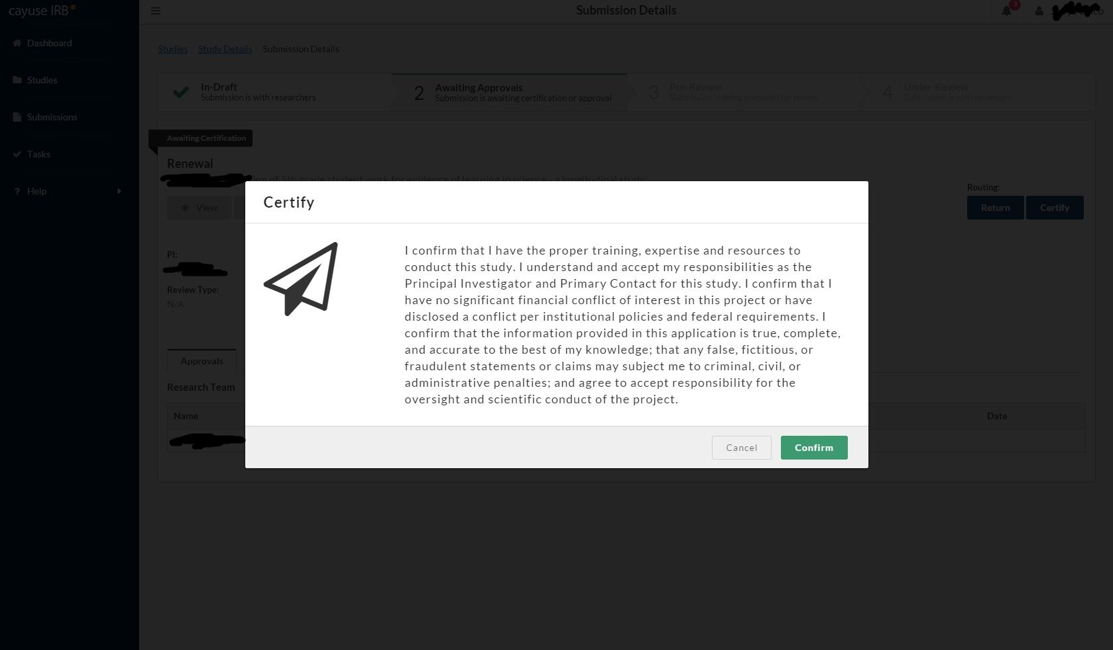
Read and select “Confirm”.

Slide 14
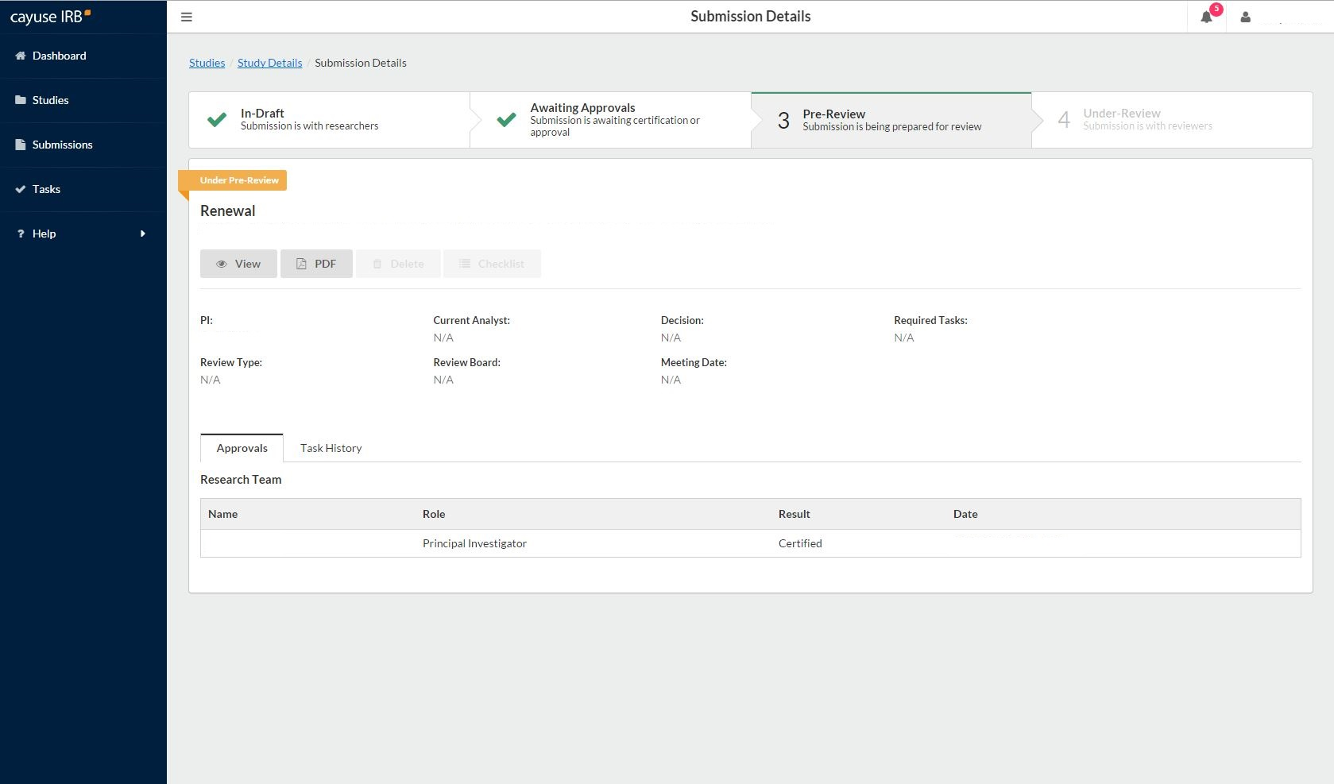
After you have certified, the submission details page should look like this. The study protocol is now “Under Pre-Review” which means it’s with the IRB office. You and any co-PIs should receive an email confirmation of the action and submission type you did.

Slide 15
For a withdrawal ….
X
For a withdrawal, your not-yet-approved study protocol won’t appear in the X’d box. Find it in the box with the red arrow and select the protocol. Then select “New Submission” tab at the top of the screen and a drop-down menu with the option “Withdrawal” appears. Follow the processes.

Slide 16
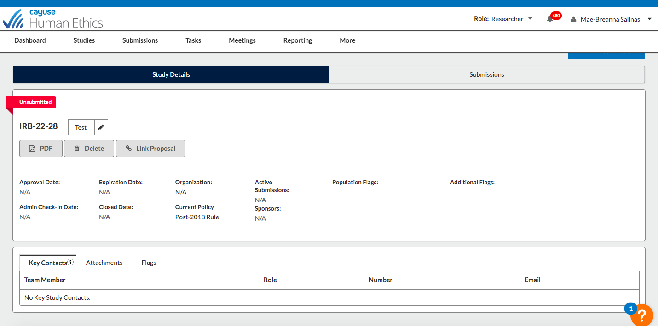
Changing a Study Title…
After select your study from the dashboard, hover your cursor over the title on the Study Details page. Clicking in that text box should allow the study title to be edited. After making any edits, the change will need to be saved by selecting the blue checkmark that appears immediately below that field.

Slide 17
If you have any issues or questions, please contact the IRB Office: irb@chapman.edu or (714) 628-2833 and for IRB Consent Templates and links, visit our website at https://www.chapman.edu/research/integrity/irb/forms-and-instructions.aspx
As this is a new IRB system, if you find any issues (typos, unclear questions, etc.) please let us know!

