Slide 1


The CITI Program Mission Statement
The Collaborative Institutional Training Initiative (CITI Program) is dedicated to promoting the public’s trust in the research enterprise by providing high quality, peer-reviewed, web-based educational courses in research, ethics, regulatory oversight, responsible conduct of research, research administration, and other topics pertinent to the interests of member organizations and individual learners.
These materials are designed and regularly updated to:
Enhance the knowledge and professionalism of investigators, staff, and students conducting research in the United States and internationally
Educate members, administrators, and leadership of ethics committees that review and oversee research
Promote ethical research at organizations through the education of research administrators and organizational leadership
Training on regulations with CITI
This presentation is intended to provide helpful information which will allow you to register for CITI training with ease as a member of the Chapman University research communities, including the various ethics committees.
Link to the CITI Training Website: https://www.citiprogram.org/
(version 2 November 2017)

Slide 2
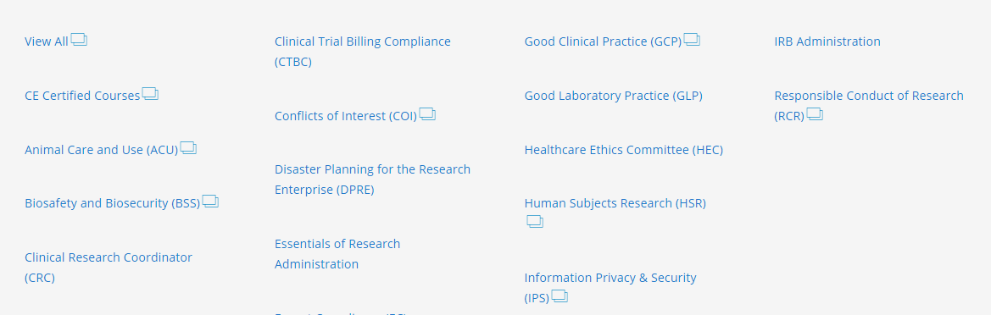

Research Training Topics
CITI provides training in many areas of research as above.
Upon completion of a group of modules, a transcript is sent to you and Chapman University. You may need this transcript later for classes, research, grant applications, etc., so please make sure to save it.

Slide 3

Registering yourself with CITI
A tutorial in order to train on the regulatory aspects of research.
This is the opening screen at https://about.citiprogram.org/en/homepage/.
If you have registered before, click on Log In. If you have registered with another institution, log in with your existing credentials. You will be able to affiliate yourself with Chapman University as well.
If you need to register, click on Register. Follow the instructions on the next pages which tailors the registration process to Chapman.
Note that different languages for CITI training are available.

Slide 4
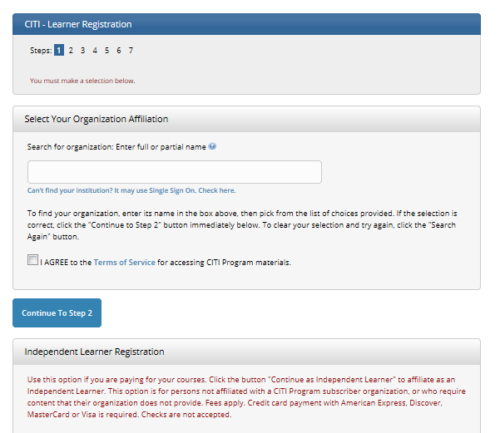

1st – Select the Institution
Note that this is step 1.
Start typing Chapman University…
Agree to the Terms of Service and continue.
Skip this section on independent learner registration. Chapman provides this training to you through the Office of Research free of charge, 24/7.

Slide 5
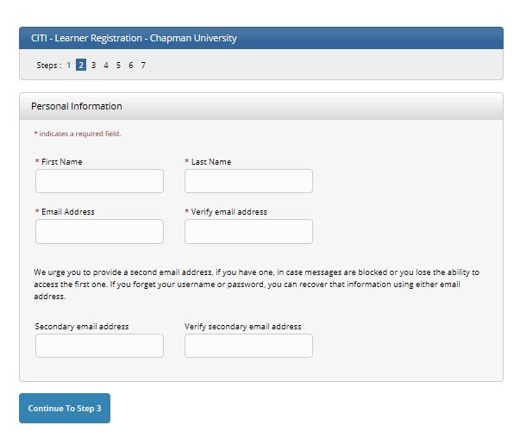
2nd – Provide Personal Information
Note that this is step 2.
The email address does not have to be your Chapman one, but it is highly recommended.

Slide 6
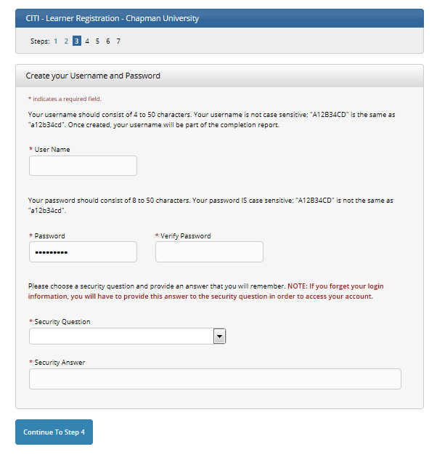
3rd – Username and Password
Note that this is step 3.
The username can be the same as your Chapman identity.

Slide 7
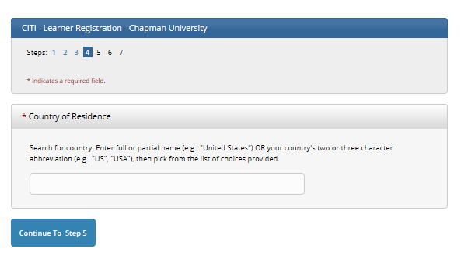
4th – Country of Residence
Note that this is step 4.
CITI is available all over the world and in many languages. If you leave Chapman, you can bring your CITI training with you.

Slide 8
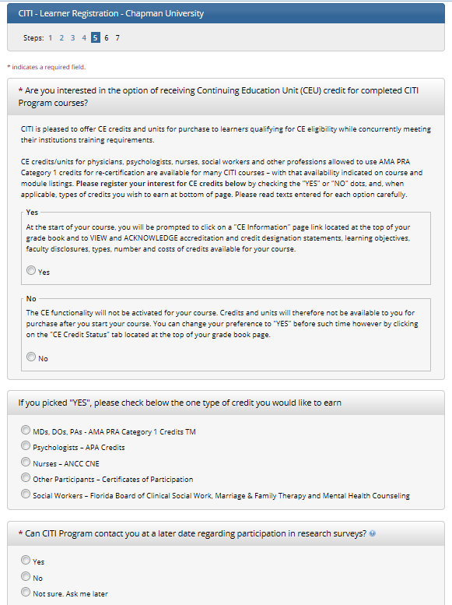
5th – Need CEU credit elsewhere?
Note that this is step 5.
This is continuing education for other purposes. Chapman University does not collect this information. You may skip it.

Slide 9
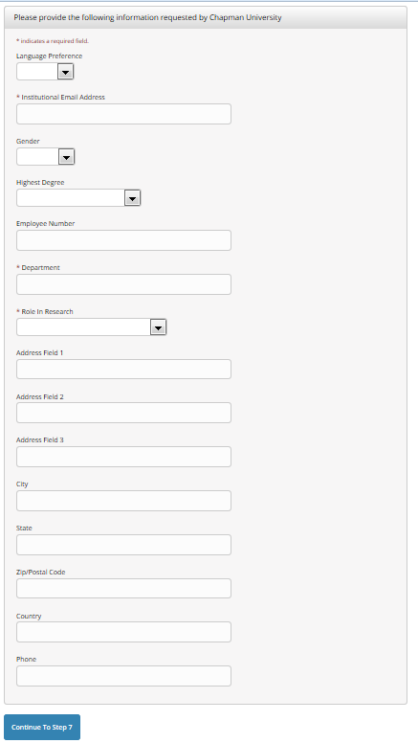
6th – Personal data
Note that this is step 6.
The Institutional Email Address is of course Chapman University. It’s acceptable to enter a Gmail or other account address.
For Department, enter your major or where you work.
For Role in Research, chose the closest one to what you do. You could be both research staff and a PI, for example.
Chapman does not collect the other information. There is no need to provide it.

Slide 10
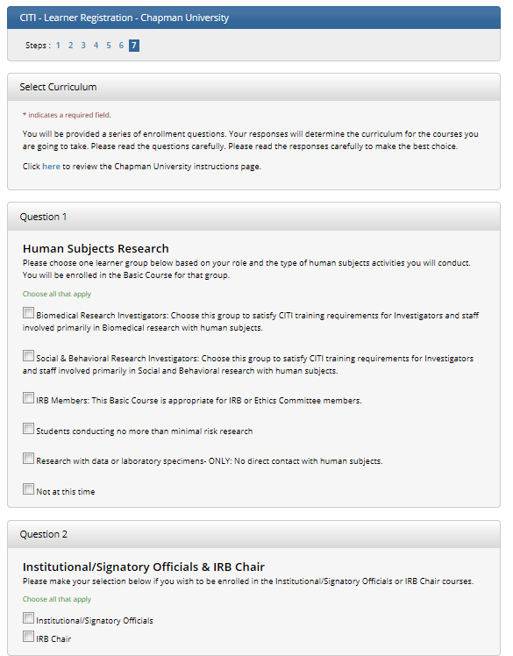
7th – Select Curriculum
Note that this is step 7.
This is the page for selecting the training you need to do, which can be in several disciplines. The options stretch, so you will need to scroll through.
  Question 1: Human Subjects Research
  Question 2: Institutional/Signatory Officials & IRB Chair
  Question 3: Responsible Conduct of Research
  Question 4: Biosafety/Biosecurity Course
  Question 5: Health Information Privacy and Security (HIPS)
  Question 6: Good Clinical Practice course
  Question 7: Laboratory Animal Welfare
  Question 8: Conflicts of Interest course
  Question 9: CITI US Export Control
  Note: As Chapman adds modules, the choices may not appear exactly the same on-line.

Slide 11
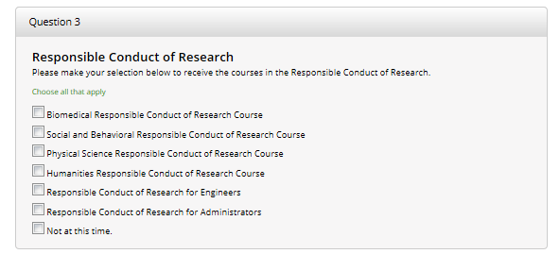
7th – Select Curriculum
(first continuation)
Note that this is more of step 7.
Question 3 is Responsible Conduct of Research, often abbreviated RCR. These training modules are often used to satisfy in part the RCR training required by NSF and NIH grants. Face-to-face training may also be mandated.
Question 8, which appears on the next slide, is for Conflicts of Interest. It may also be required by various funding and granting agencies.

Slide 12
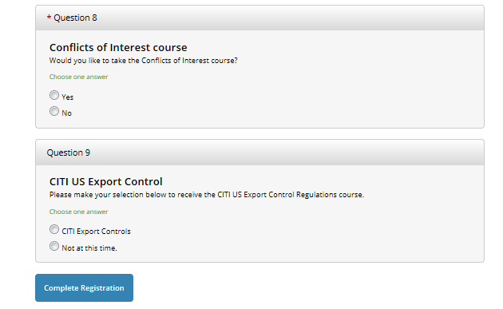
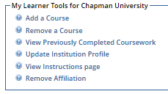
7th – Select Curriculum
(second continuation)
Note that this is more of step 7.
Question 8: Conflicts of Interest course is the only *’ed course, which means you must answer it.
You can come back and select additional curriculum. Once registered, your home page will show this box of choices. You can select “Add a course.”
When finished choosing your training courses, click the Complete Registration button.
You should be ready to start your training.

Slide 13
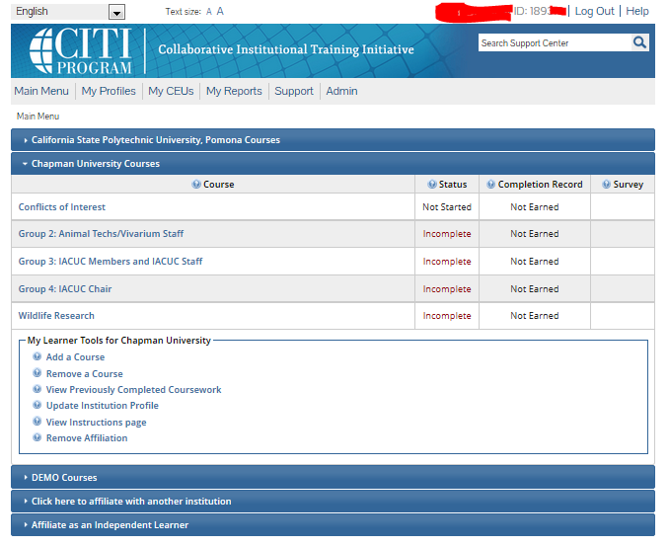
Helpful hints, once registered
To obtain documentation of your training.
Your name and CITI identity number will be up here.
Courses to take will be listed here, along with status.
Your institutional affiliations will be here.
Add and remove courses here.
If you go some-where else or come to Chapman, re-affiliate here.

Slide 14
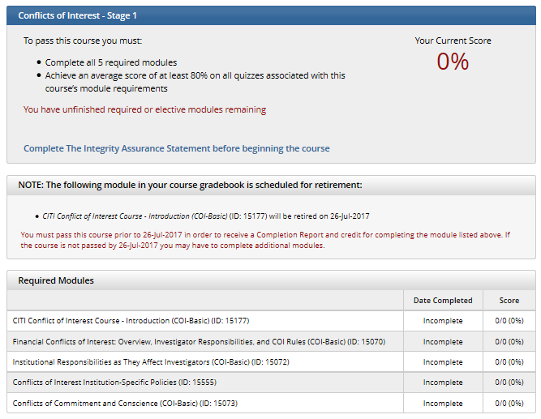
Click on a course to enter and learn!
The example shows having clicked on COI or Conflicts of Interest.
Much information is provided about progress with this course.
Be sure to complete the Integrity Assurance Statement. It will need to be done each time you select a new course to complete. You declare that you are being ethical about taking the training. See the next slide.
CITI updates its courses regularly as the world of regulations changes. There is an informative note here.

Slide 15
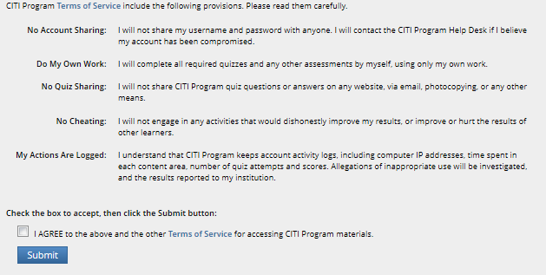
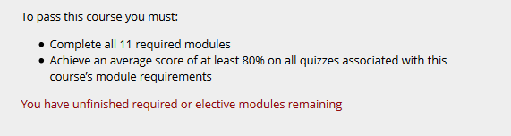
Detail from the
Integrity Assurance Statement
After reading, agreeing, and clicking SUBMIT, the box at right will show.

Slide 16
Details about Renewing Training
The CITI subscription should automatically remind you by email when it’s time to update your training obligation for research activities.
Most training is valid for three years. Check your CITI training transcript for period of time and enter a reminder in your electronic calendar, such as occurs in Outlook.
“Things” about regulations, processes, expectations, etc., do change. Researchers and instructors using animals need to keep up with the information.
Contact either the CU Office of Research or IACUC with concerns, questions, and suggestions regarding your IACUC training.

Slide 17

Congratulations!
You have gained ethical training.
You have now viewed the CITI registration process for Chapman and are informed about the CITI website and training. Be sure to print and/or save your training records in order to provide evidence of course completion.
Good luck in your career with research and regulations. Thank you for being a part of this ethical process.
Follow this link for instructions from the CITI group on how to obtain your CITI training report and determine whether your research ethics training needs to be renewed or updated.
https://support.citiprogram.org/customer/portal/articles/288752-when-will-the-citi-program-mail-fax-or-e-mail-my-official-certificate-?b_id=2337

