Slide 1
Institutional Review Board
Cayuse IRB Submitting Reliance Agreements

Slide 2
Reliance Agreement
Reliance Agreements or IRB authorization agreements (IAAs) enables one institution to be the IRB of record, and other collaborators may rely on a single IRB approval.
Reliance Agreements are not needed for Exempt research studies since they are exempt from the federal regulations. So, reliance agreements are only used for studies that require expedited or full IRB review.
People who are considered engaged in research obtain:
data about participants through intervention or interaction, or manipulation of the participants' environment; or
for research purposes, identifiable private information or identifiable biological specimens from any source; or
the informed consent of human participants for the research.

Slide 3
Before You Begin…
For instructions on how to sign in, navigate, and submit new applications (.pptx)
For more information on reliance agreements, please visit: https://www.chapman.edu/research/integrity/irb/single-irb-reviews.aspx
Office of Research Integrity and Compliance v1-2024

Slide 4
Table of Contents
Chapman is relying on external IRB……………………………………………………..5
Chapman is the IRB of record………………………………………………………………8
Adding External Collaborators via Modification…………………………………12

Slide 5
Institutional Review Board
Chapman is Relying on External IRB

Slide 6
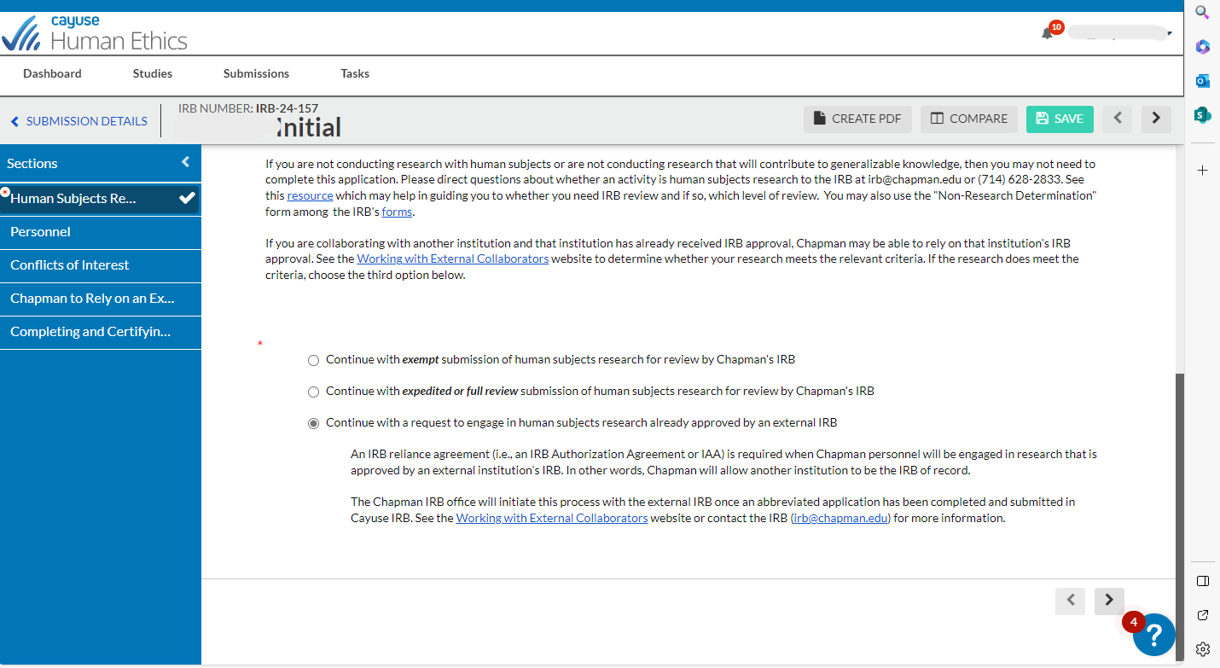
If you are creating a new initial submission in which Chapman is relying on an External IRB (i.e., another institution is the IRB of Record), select the third option and a new section will appear
This section will appear after selecting third option below
Select this option if relying on external IRB

Slide 7
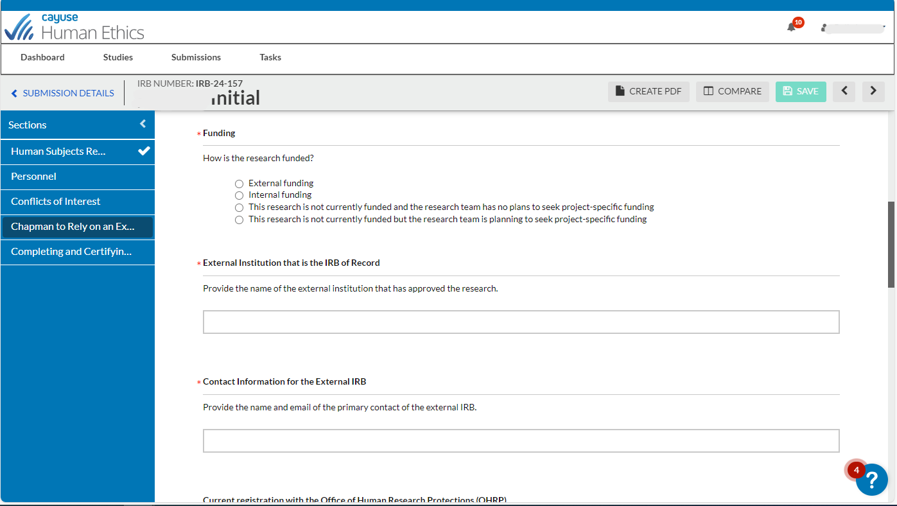
Fill out all required questions in each section. Required questions are marked with a red asterick (*)
After completing all sections + required questions, follow the steps of certifying and completing the submission

Slide 8
Institutional Review Board
Chapman is the IRB of Record
(i.e., another institution is relying on Chapman’s IRB)

Slide 9
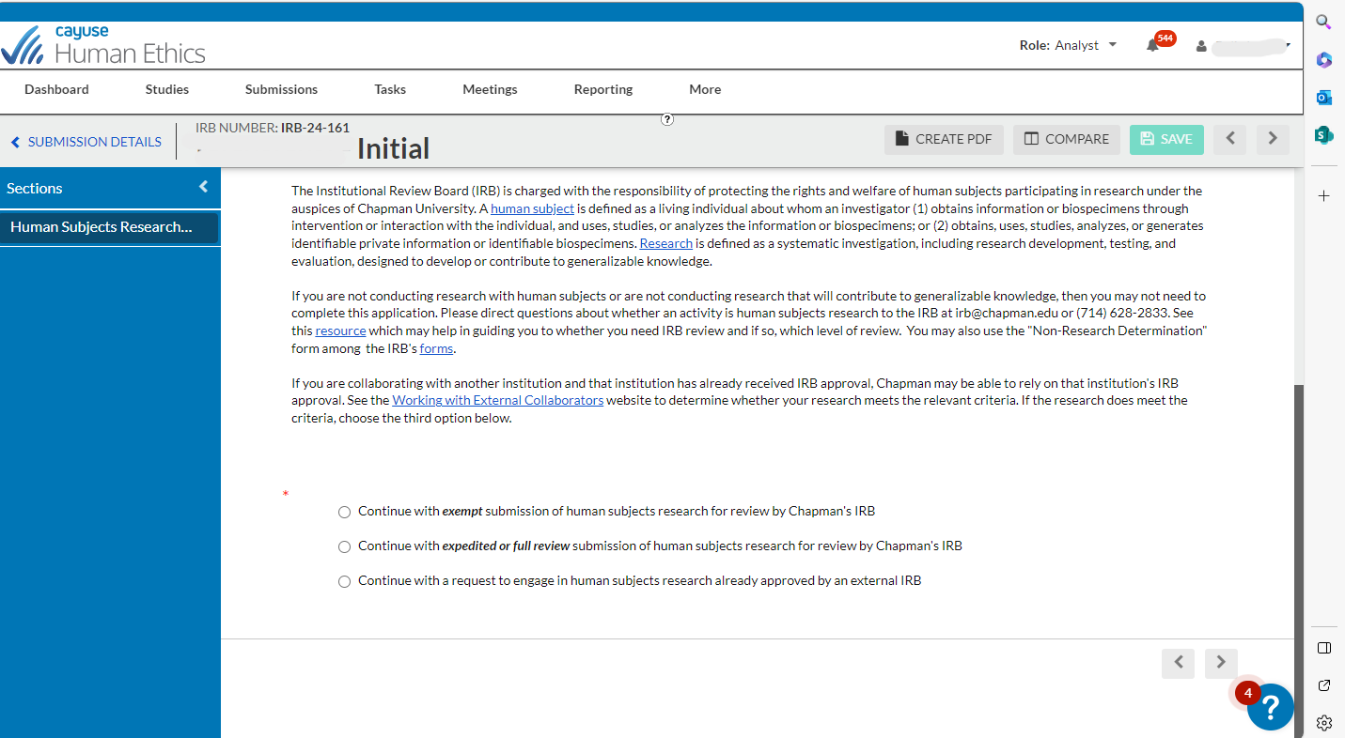
Exempt studies don’t have a Chapman IRB of record section, since each institution must review each exempt study. There is no Federal requirement for IRB review for exempt studies.
IRB Review is Federally required for expedited or full reviews. The following slides in this section are based off selecting expedited or full review

Slide 10
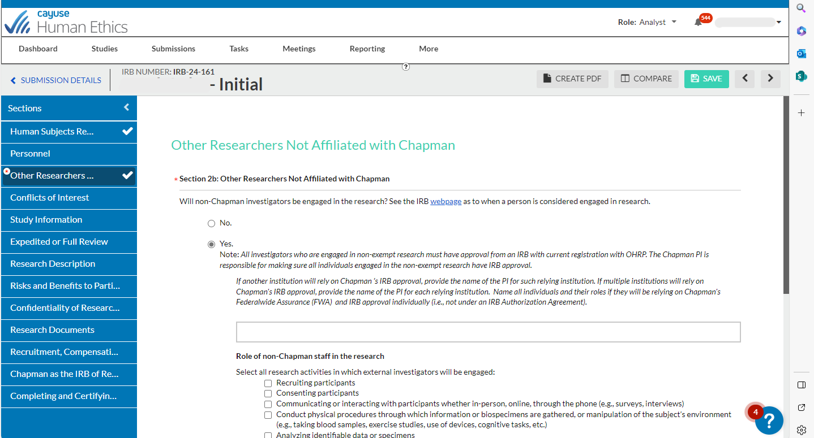
If working with non-Chapman researchers, select “Yes” and fill out all questions
After selecting “Yes”, this section will appear. If selecting “No,” then this section will not appear

Slide 11
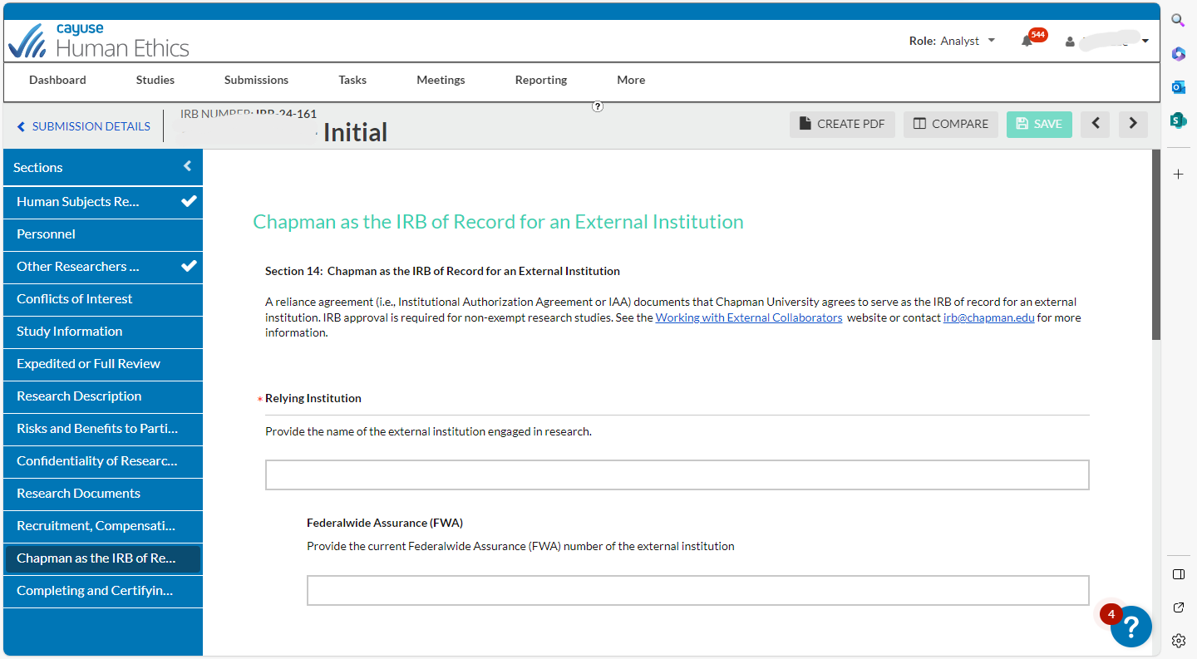
Fill out all required questions in each section. Required questions are marked with a red asterick (*)
After completing all sections + required questions, follow the steps of certifying and completing the submission

Slide 12
Institutional Review Board
Adding External Collaborators via Modification

Slide 13
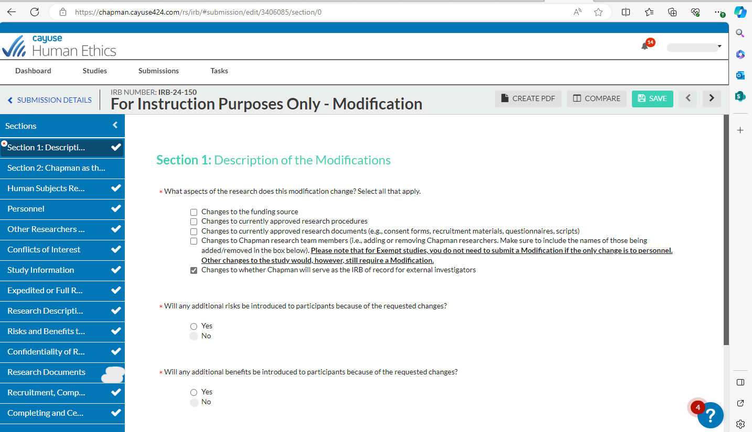
This section will appear after selecting the below option
If you are creating a modification submission in which you are making changes to whether Chapman will serve as the IRB of record for external collaborators, select this option.

Slide 14
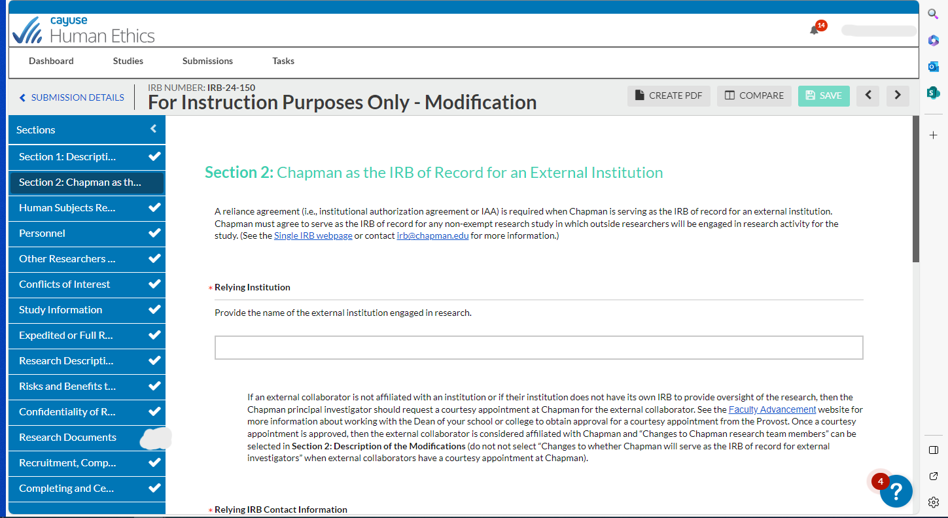
Fill out all required questions in each section. Required questions are marked with a red asterick (*)
After completing all sections + required questions, follow the steps of certifying and completing the submission

Slide 15
If you have any issues or questions, please contact the IRB Office: irb@chapman.edu or (714) 628-2833

