Slide 1
Characteristics of COVID-19 morbidity and mortality
Chapman Virtual Town Hall
May 19, 2020
Steven Gjerstad
Economic Science Institute

Slide 2
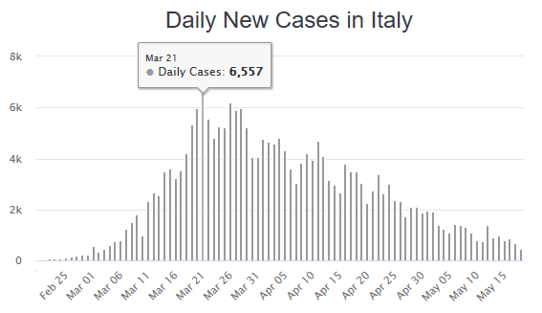
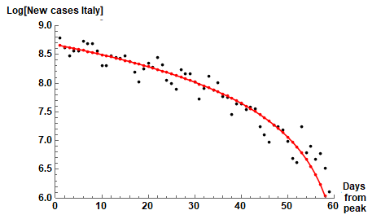
The dominant model of infectious disease (the S-I-R model) predicts exponential decay for a replication rate below 1.
That is not correct or not applicable.
“It is the conjunction of formal model and empirical interpretation which ... is most properly called a theory.”
-Donald Davidson, Patrick Suppes, and Sydney Siegel
Daily new cases in Italy are 7% of peaked daily new cases on March 21st.
Similar pattern in Australia, Belgium, Denmark, France, Germany, Ireland, Japan, New Zealand, Norway, South Korea, Spain, …

Slide 3
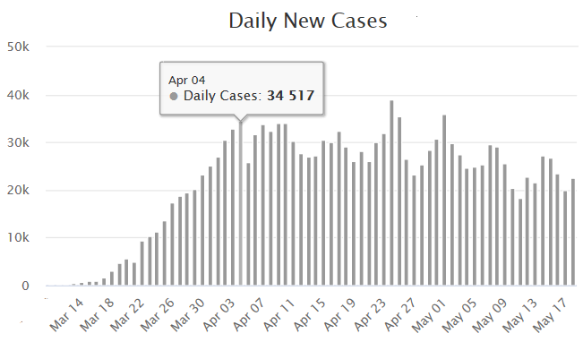
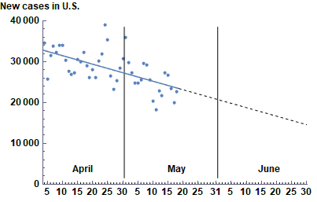
Exponential growth phase ended 45 days ago in the U.S.
Similar countries: Canada, Sweden, U.K.
As of yesterday: 1.55 million cases.
At current rate about 4 more months to reach a few cases per day.
About 1.3 million more cases.
Total of 2.85 million cases.
CFR is about 6% so about 175,000 deaths.

Slide 4
Different outcomes from infection to death indicate the extent of vulnerability of different demographics
Who gets infected? (Serological survey from Instituto de Salud Carlos III)
Who gets tested? (New York City Department of Health)
Who gets hospitalized? (New York City Department of Health)
Who dies? (New York City Department of Health)

Slide 5
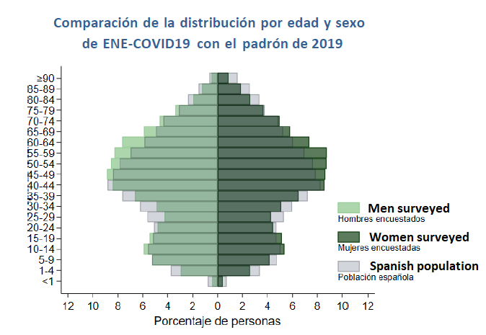
Source: Estudio ENE-COVID19: Primera Ronda Estudio Nacional de Sero- epidemología de la Infection por SARS-COV-2 en España, Informe Preliminar 13 de Mayo de 2020.

Slide 6
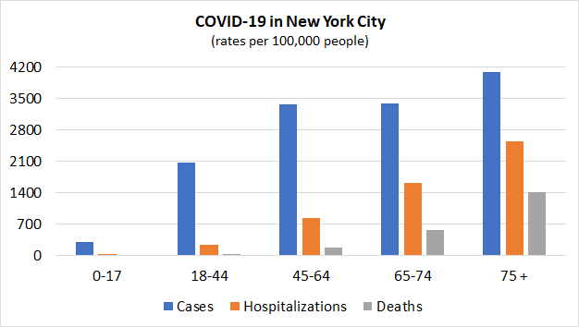
Source: New York City Department of Health (https://www1.nyc.gov/site/doh/covid/covid-19-data.page)

Slide 7
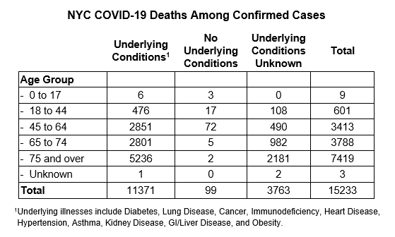
Source: New York City Department of Health
(https://www1.nyc.gov/assets/doh/downloads/pdf/imm/covid-19-daily-data-summary-deaths-05132020-1.pdf)

Slide 8
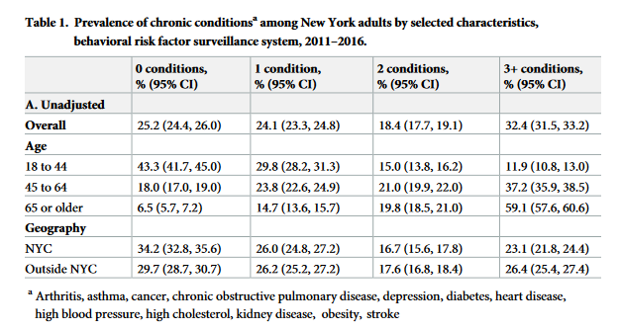
Source: Newman D, Levine E, Kishore SP (2019). «Prevalence of multiple chronic conditions in New York State, 2011–2016,” PLoS ONE 14(2).

