Slide 1
Grant Proposal Workshop
Dr. Julye Bidmead, Director
Center for Undergraduate Excellence

Slide 2
Steps to Success
Start early!
Read the entire application carefully
Answer all of the prompts/questions
Writing a successful research proposal is a process.
Be prepared to write multiple drafts

Slide 3
Steps to Success!
Voice:
Write to an educated, but not specialized audience
Write simply and clearly
Precise, concise, objective, and persuasive

Slide 4
Steps to Success Writing to Persuade
A proposal seeks to convince or persuade the grant reviewer
The tone of the writing plays a big role in persuading the reviewer
Using the right tone can be tricky
Be persuasive
Not impassive (dry) or arrogant (overconfident)

Slide 5
Steps to Success
Ask for help from professors and advisors
Proofread before submitting
Turn it in ON TIME!
CUE -Due
No applications will be accepted in hard copy or vial email. The online submission portal is located in the CUE website on the Scholarly/Creative Grants web page.

Slide 6
General: What is a grant proposal?
Who, what, when, where, why, and how you will conduct your research/creative activity
Follows conventions of your discipline
Asking for $$$

Slide 7
General: What is a grant proposal?
Research Questions→ Objectives→ Methodology → Results
Successful proposals show connections between research questions, objectives, methods, and results.

Slide 8
General
What:
Is the central research question, creative inquiry and/or purpose of the project?
Does it attempt to solve a problem? Or What do you want to discover?
Why:
Why (and how) is your research/creative project important to the field of study?
Does it make a contribution to the area of inquiry?

Slide 9
General
How:
How will you accomplish it? What will you do?
What methodology are you using in research or creative project?
When:
How long will it take you?
What is your schedule?
Results:
What are your expected results and/or conclusions?
What’s next? Will you turn into a senior thesis, conference paper, performance piece, film, published article, etc.?

Slide 10
General: Suggested Format
Introduction / Objectives
What / Why
Literature Review
How does your project relate to existing research on the topic?
Methodology
How?
Give specifics here

Slide 11
General: Suggested Format
Expected Outcomes:
What do you expect your research/creative activity to show?
Schedule
How and when you will complete your research/creative activity?

Slide 12
General: Must include!
What is your research/scholarly question?
How will you do it?

Slide 13
How do I know if I need IRB Approval? (Institutional Review Board)
hazardous materials?
human or animal subjects?
Not sure:
Work with your faculty mentor to ensure that the project has approvals necessary
See https://www.chapman.edu/research/_files/_files-sponsored/irb-files/cu-irb-research-determination-form.pdf
www.chapman.edu/irb

Slide 14
CUE: Required
3 pages maximum
Letter of Support provided by the Faculty Mentor
Budget
Selection is based on the following criteria:
Coherence of the Project Description
Feasibility and Value of the Project
Academic, Intellectual, or Creative Rigor of the proposed work
Originality of or Innovation in the Project
Overall Excellence

Slide 15
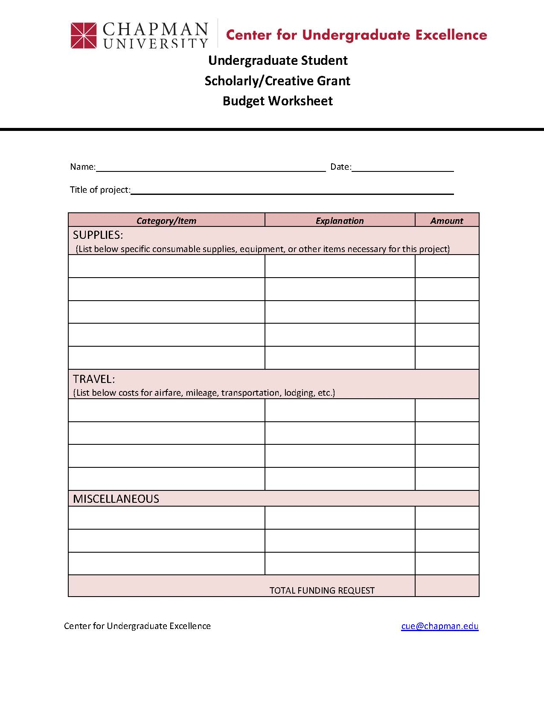
Budget
discussed in next presentation

Slide 16
CUE Specific: Letter of Support --Faculty Mentor
One letter written by the faculty mentor should speak to the nature of the proposed research or creative activity, including the roles both the fellow and the mentor will play in the collaboration. While the faculty member is encouraged to provide evidence of the applicant’s ability, the letter is not explicitly or solely a letter of recommendation for the student per se. A faculty mentor might consider giving context for the proposed project, including its potential value in the field, as well as speaking to the student’s preparation and the ways that the faculty mentor will guide or oversee the student’s work. (The letter is submitted separately by faculty mentor.)

Slide 17
General
Identify Yourself: Remind recommender who you are by mentioning classes taken, years, significant paper or project.
Why: Explain what grant (graduate program, job) you are seeking in one or two sentences. Attach grant proposal and resume.
Request LOR: “I am wondering if you would you be able to confirm my preparation to undertake this project/graduate study/job.”
Provide Deadline: “If so, I will send you submission information. The grant deadline is DATE.”
Be Available: “Please let me know if you have any questions about the grant requirements or my project. I am happy to meet to provide additional information at your convenience.”
Ask as early as you can!

Slide 18
CUE Specific:
Awards are intended to provide support for a variety of faculty-mentored scholarly or creative projects conducted by students. Grants typically do not exceed $1,000 but all reasonable proposals will be considered. Funds may be used for a number of purposes, including (but not limited to):
purchase of equipment, materials, or supplies directly related to the project.
Facility rental, copyright fees, and other costs associated with creative productions.
Non-material expenses directly related to the project such as test subject remuneration, license fees, or external lab analyses.
travel expenses required to conduct the creative activity or scholarly research, such as working in an archive or collecting field data

Slide 19
