Slide 1
NSF CAREER WORKSHOP Tips for Success Thomas Piechota – Office of Research Christopher Kim – Schmid College of Science and Technology
Jennifer Funk - UC Davis

Slide 2
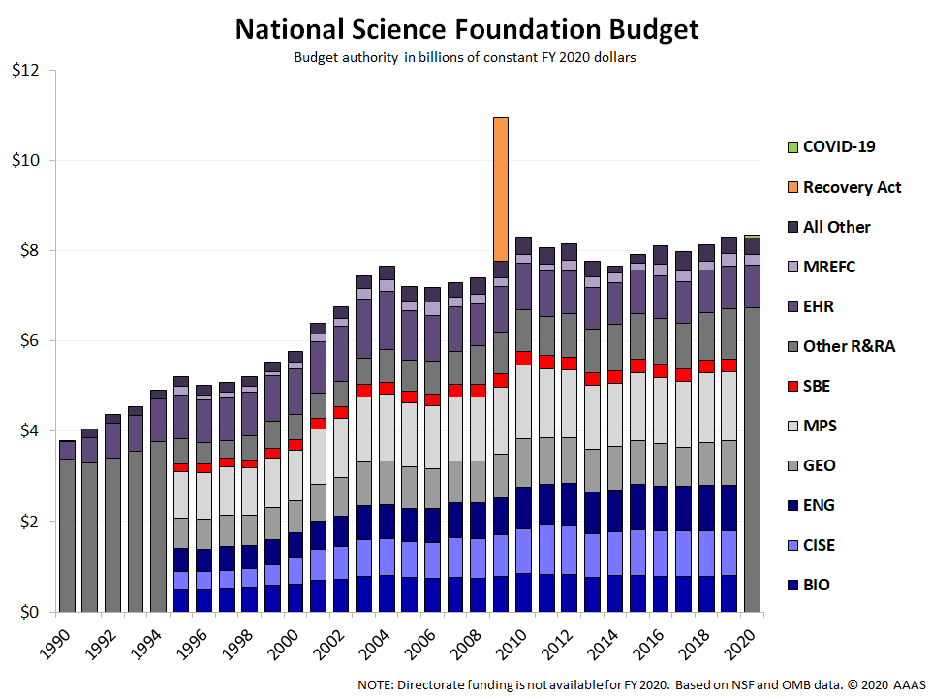
NSF Funding has been increasing $10B proposed for next budget

Slide 3
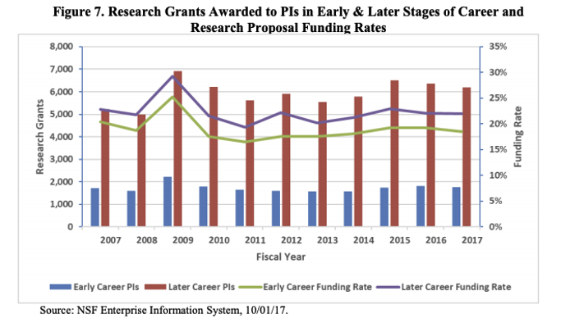
NSF Funding Success Rates

Slide 4
What is NSF CAREER?
Program to support activities for early-career faculty (pre tenure at time of proposal submission) that build firm foundation for a lifetime of leadership in integrating education and research.
Available for all Directorates...due July 26, 2021
MY CAREER PROPOSAL
Introduction
Research
Education
1 Page
Introduction to research your accomplishments
You need to do some bragging here!
8-10 pages
Concisely present research ideas
Use preliminary data where appropriate
Use charts/tables to show components of research
4-5 pages
Show an understanding of best (high impact) practices in your field
Leverage existing resources/programs (e.g., CUE)

Slide 5
Ingredients for a Strong Proposal
Idea with high merit and broader impacts
Well written proposal (accessible to a broad audience)
Integrated research and education plan that is feasible
Compelling Department Letter showing institutional commitment
Letters of collaboration (if applicable)…not support
Budget that is consistent with all research and education activities ($400K- $500K depending on Directorate over 5 years)

Slide 6
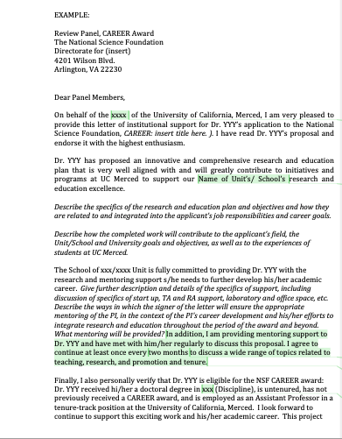
Department Letter
Department commitment to PIs activities
Description of how Pis career goals and responsibilities align with institution
Description of professional development and mentoring
Statement indicating PIs eligibility (non-tenure at time of proposal submission)

Slide 7
Other Tips – Start Early end of July Deadline
3-6 months
2 months
1 months
1-2 weeks
Review program announcement in detail
Identified specific Division or Program
Reach out to Director of program with summary
Follow up if needed with Director of program
Dedicate time for proposal writing
Contact Sponsored Projects Services (SPS)
Letter of support from Chair
Contact collaborators
Complete first draft
Send to colleagues for feedback
In discipline and/or someone who had a CAREER
Finalize budget with SPS
Follow up on letters
Incorporate revisions
Make list of suggested reviewers
Work with SPS to upload materials
Ensure all other sections are complete (e.g., facilities, data)

Slide 8
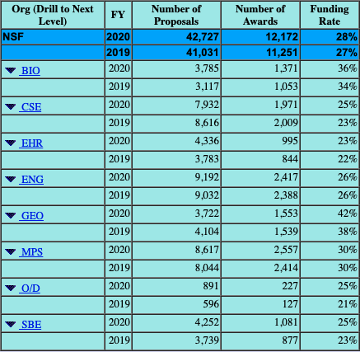
Other Tips
If you get accepted, read critically the reviews and how they might improve the activities
If you get rejected, revise based on comments and resubmit! You can submit 3 times
Funding rates vary depending on Directorate (20-30%)
Common reasons for non-compliant proposals
Co-principal investigator listed on the cover page
Departmental Letter is missing
Proposal submission occurs after the deadline
Proposal topic is not appropriate for NSF
Project description is missing Results from Prior NSF Support Section, if applicable

Slide 9
Questions?
piechota@chapman.edu
Feel free to contact me if you want to see my CAREER Proposal
or
You need yours to be reviewed

