Slide 1
The Response of Higher Education Institutions to the Outbreak of COVID-19
Greg Goldsmith, Ph.D.
Director of the Grand Challenges Initiative
in collaboration with
Kendra Ellertson ‘21, Lauren Sanchez ‘21, Natasha Lindert ‘21, Sydni Au Hoy ‘22, Ashley Okhovat ‘22, Nicholas Mirchandani ‘21, Kristen Nieders ‘21, Corey McCrea ‘21, Cailyn Sakurai ’21, and Jessica Pratt ‘21

Slide 2
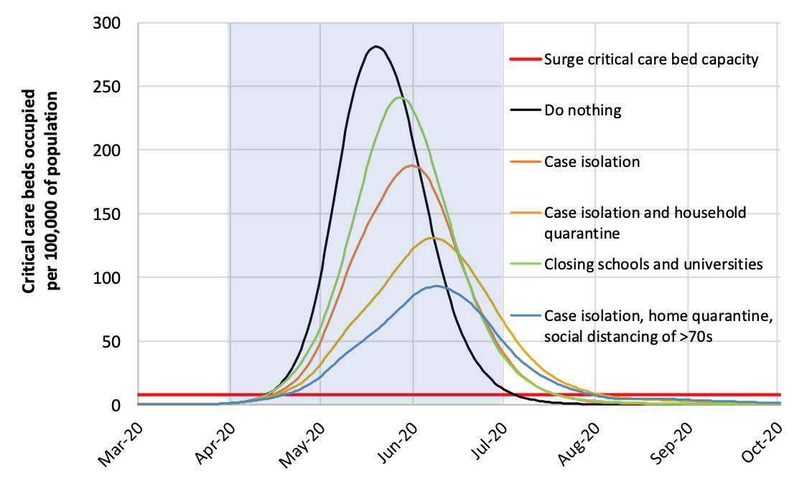
How and when did institutions respond to the emergence of COVID-19?
Modelling: To what extent did campus closures affect rates of COVID-19 transmission?
Public Health: How quickly did different institutions respond to information and guidelines from health officials?
Higher Education: How did the characteristics of the institutions (e.g. size, public vs. private) affect the decisions?
Closing Schools Slows the Transmission of COVID-19
HOSPITAL BEDS NEEDED
Ferguson et al. 2020

Slide 3
Higher Education for the Common Good
-This is more than a “teachable moment.” Our students are already using science and engineering to make the world around them a better place.
-Combining science and engineering with economics, history, and sociology is critical for solving grand challenges.

