Slide 1
Institutional Review Board
Cayuse IRB Instruction Manual

Slide 2
Cayuse
Cayuse is an easy-to-use electronic system for preparing, submitting, and reviewing submissions. Both PI’s and members can easily track progress, manage submissions, and more
First Time Using Cayuse???
Go to: IRB Application System |
*Under the tab “Authentication,” follow the steps to continue the submission process

Slide 3
Before Proceeding
This tutorial is written in the point of view of a Primary Investigator (PI)
If you are not a PI, please note that there may be adjustments needed to what your role may be. If you have any questions, please email irb@chapman.edu
*If there are questions that are not answered on this Power Point, please email irb@chapman.edu or check the website for any missing/confusing information
Office for Research Integrity and Compliance v5-2024

Slide 4
Before Beginning an IRB Submission…
Make sure you have the following items ready*:
Supplemental documents in individual document files (i.e. informed consent form(s), authorization(s), recruitment documents, questionnaires, etc.) as unprotected PDF files
Faculty advisor and co-PI(s) CITI training copy of certificate
Follow the steps here: IRB Training and Continuing Education |
Ensure that you and your co-PI(s) have been “authenticated” with the IRB office. If you are unsure, contact the IRB office at irb@chapman.edu
*You do not have to finish the IRB protocol in one sitting. All information can be saved.

Slide 5
Logging In
FIRST, ensure you have been “authenticated” before logging in!
Login to Chapman’s Cayuse:
Navigate to http://chapman.cayuse424.com/ and sign in with the email that has been authenticated by the IRB. Use your Chapman email and password for easiest pathway

Slide 6
Institutional Review Board
Navigating Cayuse

Slide 7
Once logged into Cayuse, select “Cayuse IRB (Human Studies Compliance)” to continue to the next step
Office of Research INTEGRITY

Slide 8
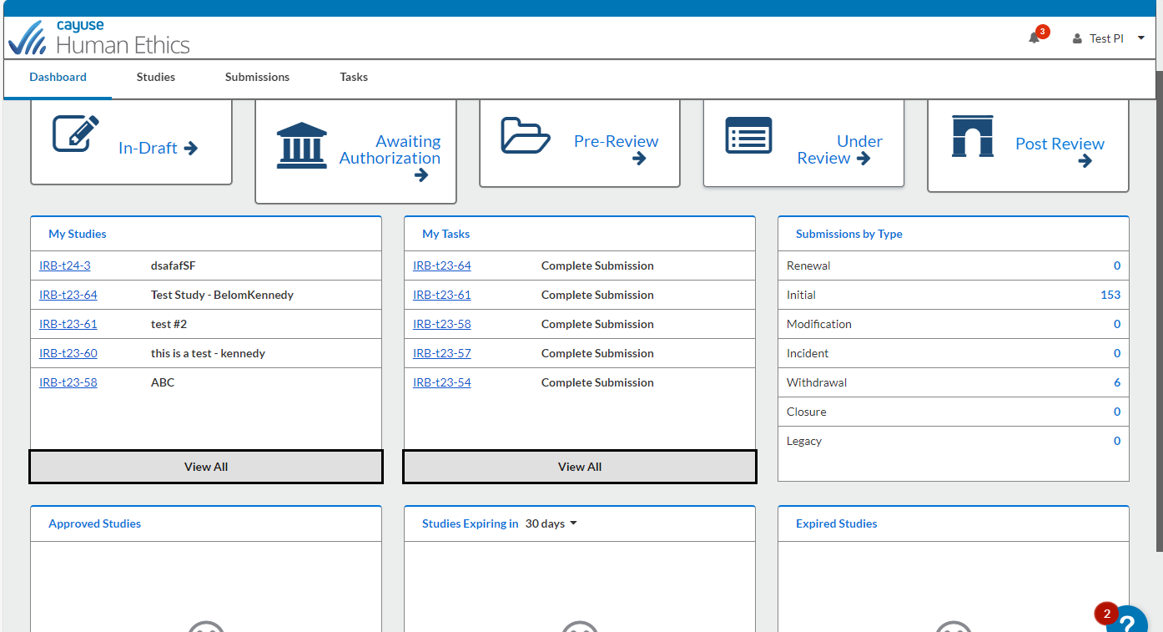
This is your Dashboard where you can navigate all your affiliated studies

Slide 9
Institutional Review Board
Creating a New Protocol

Slide 10
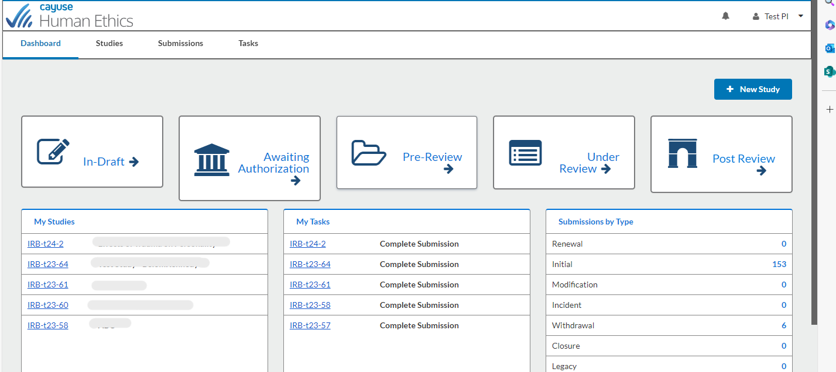
To begin a new protocol, click “New Study”

Slide 11
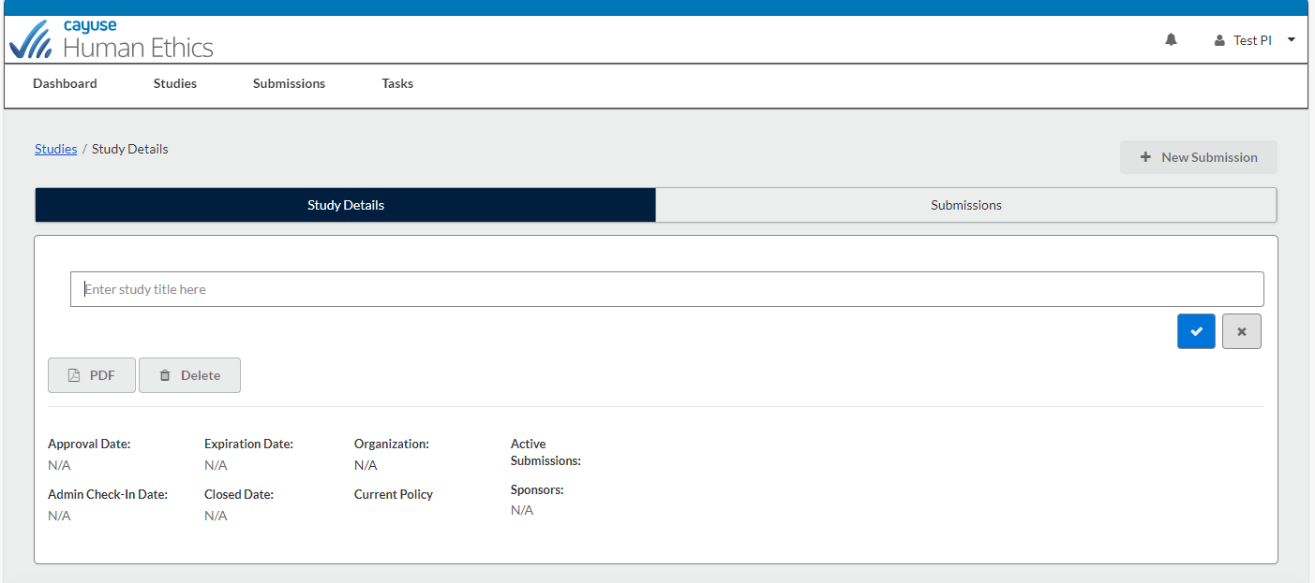
Add Study Title here
Click here to confirm creation of study and continue to next step

Slide 12
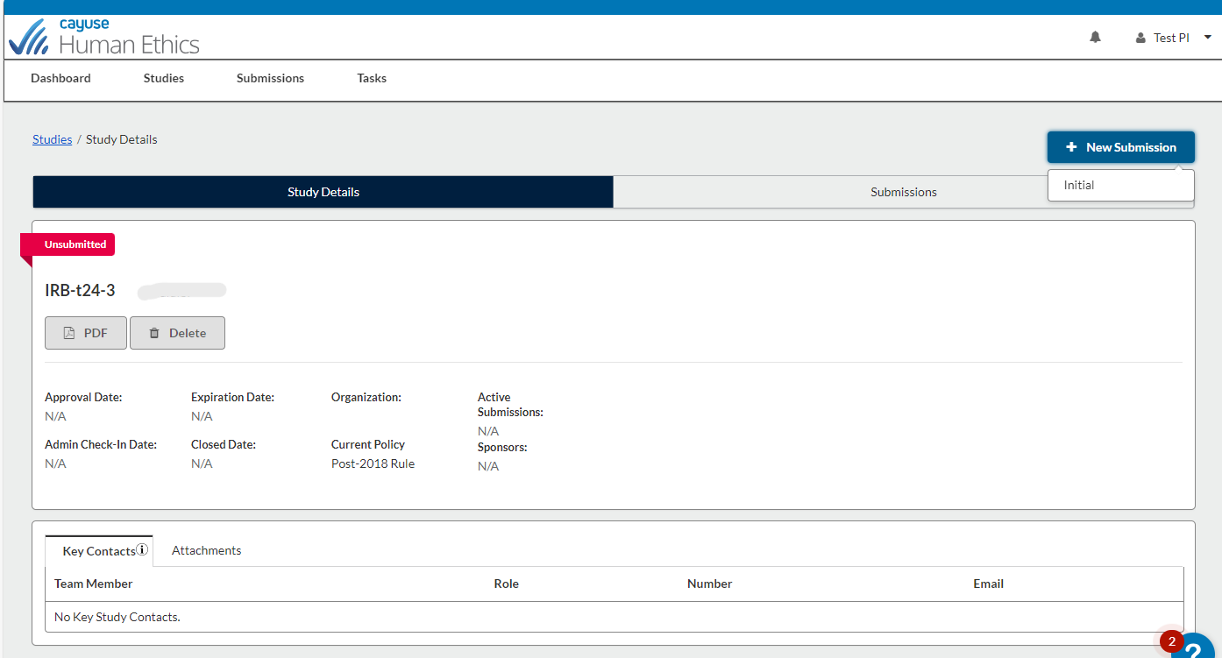
Select “New Submission” then select “Initial” to create the submission for your study

Slide 13
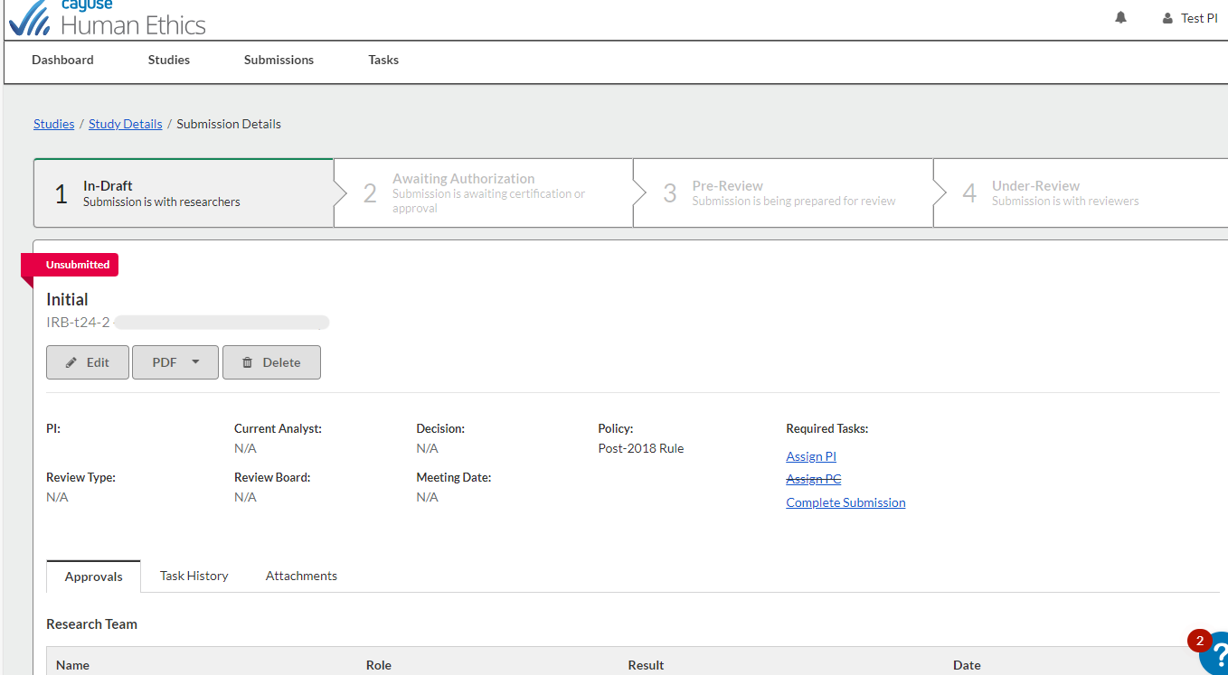
You can check the tasks you need to complete here and you can also click on the tasks to be redirected to that page
Click “Edit” to begin editing your submission

Slide 14
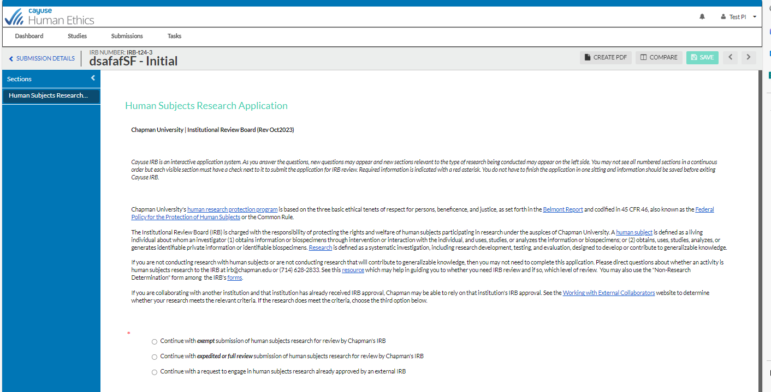
For more information on which review is what, visit: Institutional Review Board | Research Integrity | Chapman University
There are three prompts a PI can choose from: exempt, expedited/full, or external IRB. Please select the type of submission your study is most like

Slide 15
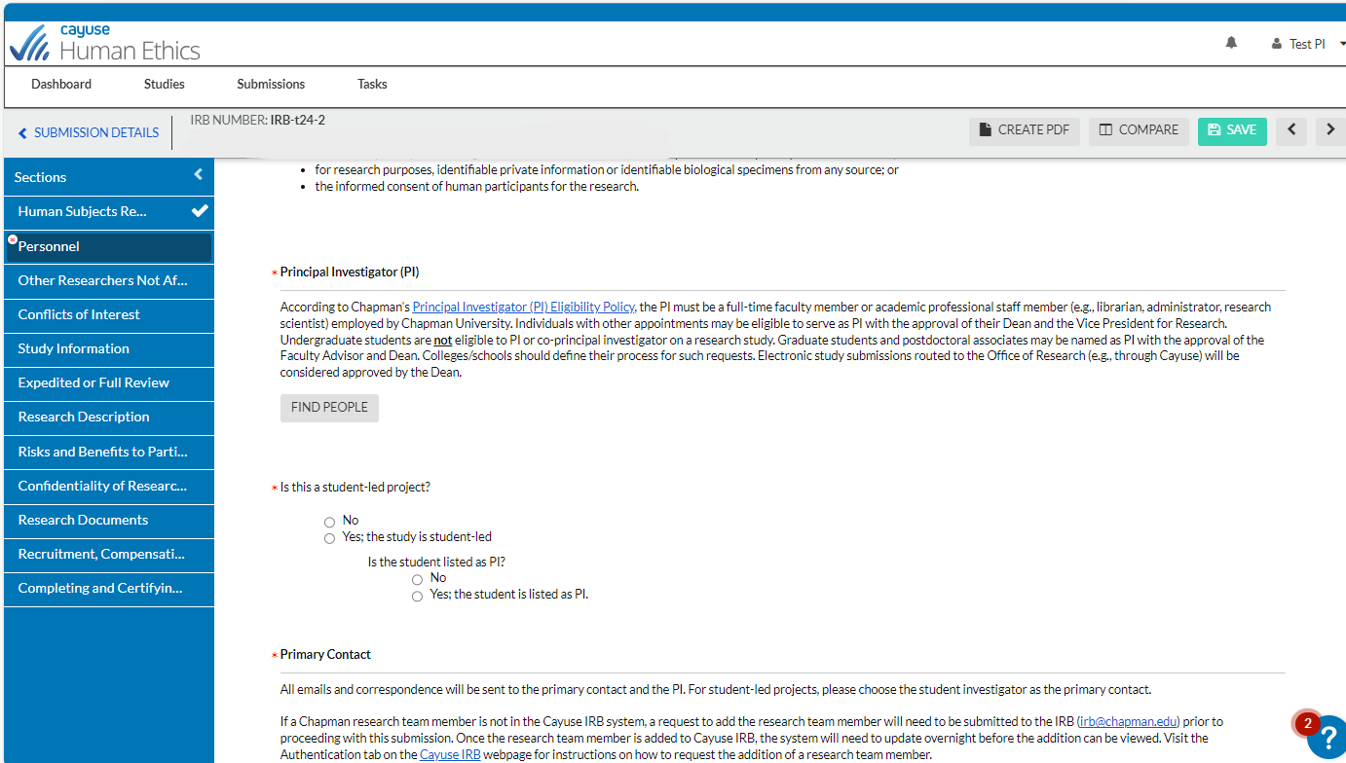
Once all required (*) questions in a section are complete, a check will appear
Make sure to Save your work if leaving the submission page
Questions with a red asterisk are required

Slide 16
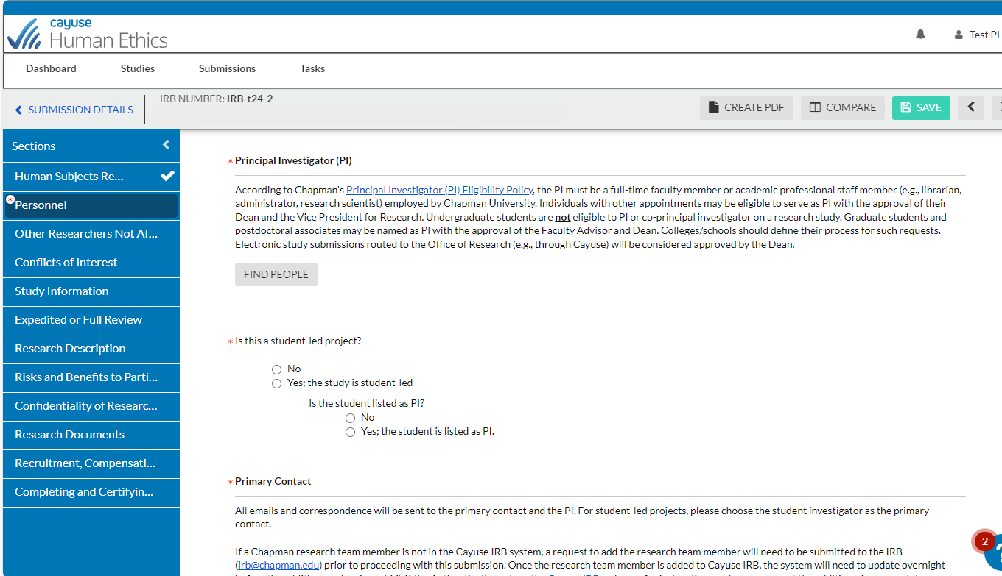
For student research, faculty sponsors or grad students MUST be the PI
Only the Principal Investigator, Co-investigators, and Primary Contact will have access to the IRB study

Slide 17
When looking for the PI, Primary Contact and Co-Investigators, click “Find People” and enter the affiliated name, which will redirect you to a new screen

Slide 18
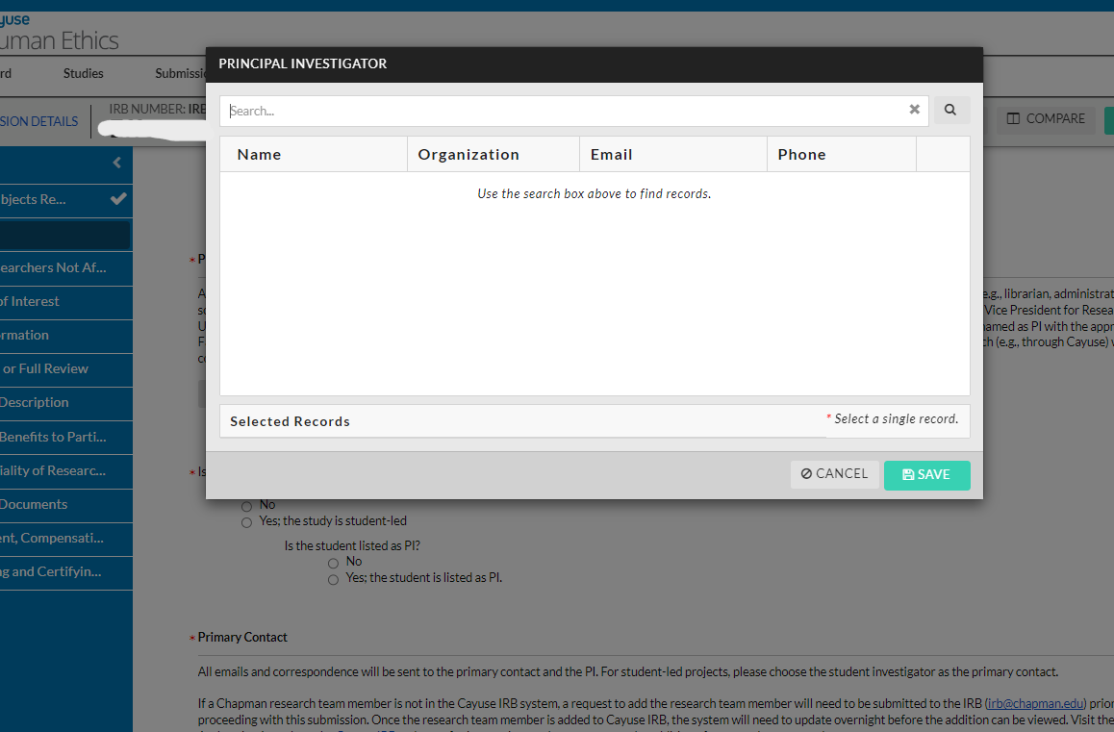
Type in full name here then press “Enter”

Slide 19
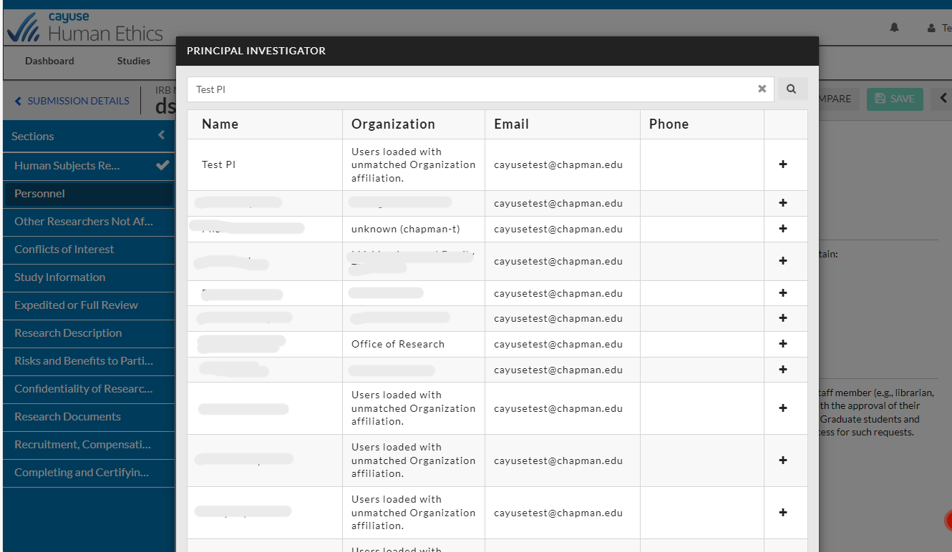
Select the typed name and select “Save” on the bottom
This process will be the same when searching for Primary Contacts and Co-PI’s. If you can’t find a name, contact the IRB office (irb@chapman.edu) to have the individual authenticated into the system

Slide 20
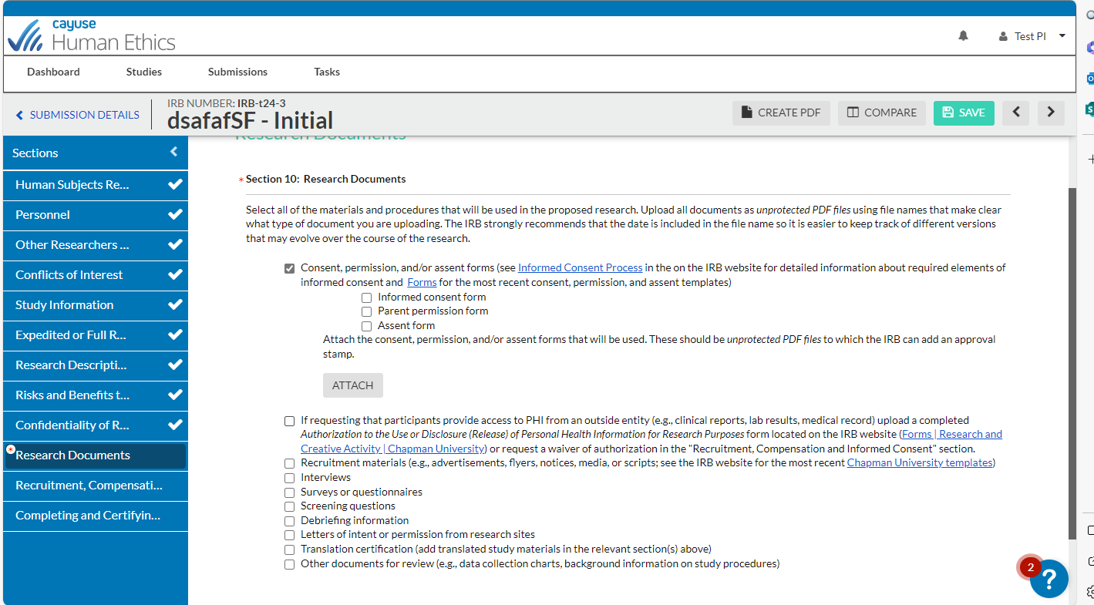
Documents will
no longer be stamped by the IRB.

Slide 21
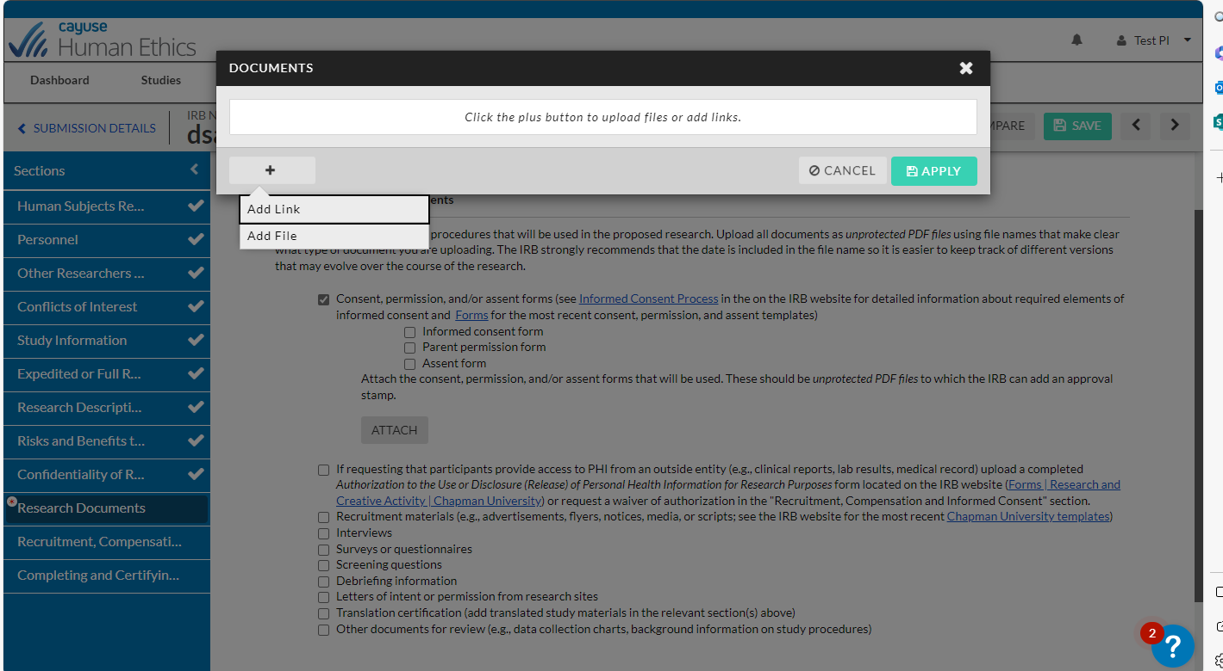
Click on the + to add documents
Click “Apply” to attach

Slide 22
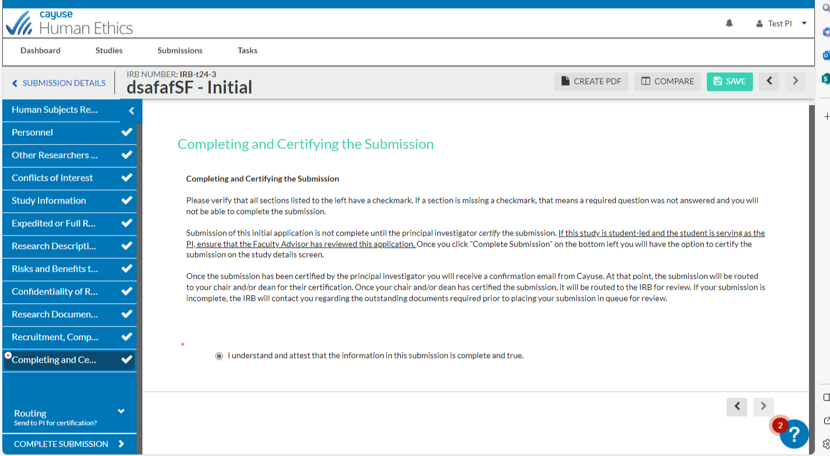
You can review your application by clicking through the sections or by creating a PDF of the protocol
Ensure all sections have been completed (has checkmark) AND have thoroughly reviewed your submission
Click on “Complete Submission” to send the submission to the PI to certify. This option will not appear until all sections are complete

Slide 23
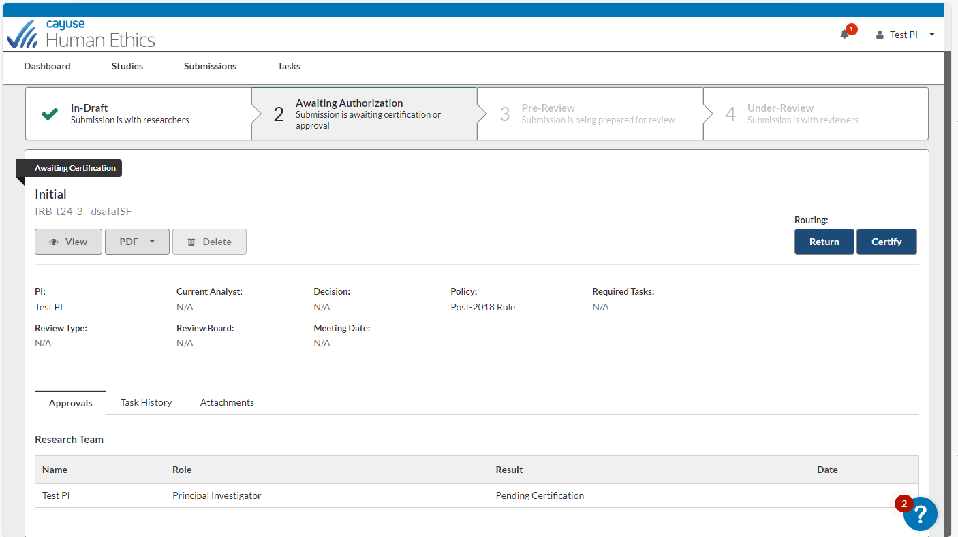
You will need to Certify each time you submit revisions, renewals, and amendments
The PI must certify the submission for it to be submitted to the IRB and if applicable, Organizational Approvers must approve the submission

Slide 24
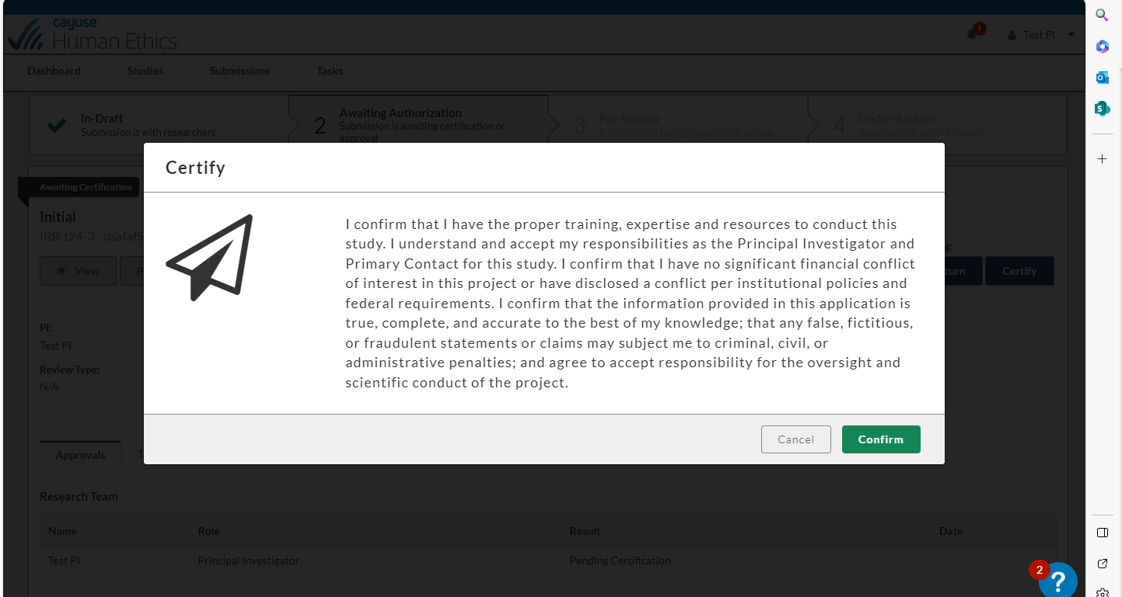
Read the certification and click “Confirm” if you want to continue

Slide 25
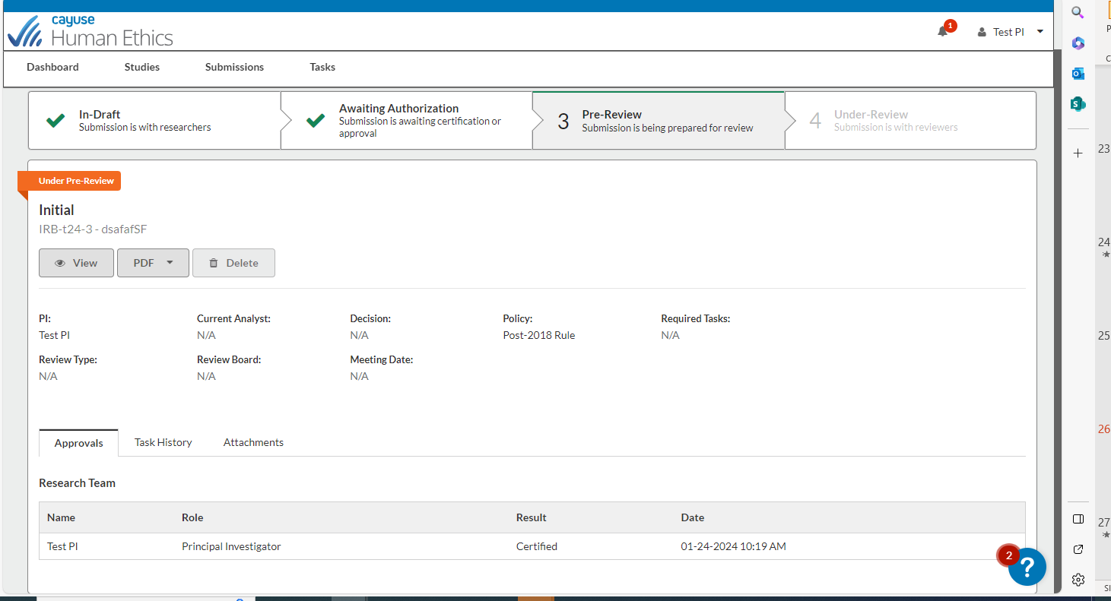
Look at these sections to monitor submission progress
Once certified by the PI (and approved by Organizational Approvers, if applicable) the application is submitted to the IRB and placed in Pre-Review

Slide 26
If you have any issues or questions, please contact the IRB Office: irb@chapman.edu or (714) 628-2833 and for IRB Consent Templates, visit our website at https://www.chapman.edu/research/integrity/irb/forms-and-instructions.aspx
As this is a new IRB system, if you find any issues (typos, unclear questions, etc.) please let us know!

