Slide 1
Institutional Review Board
Cayuse IRB Instruction Manual

Slide 2
How to use this tutorial
This tutorial is for researchers (PIs) who already have an approved IRB protocol and wish to change the study title and submit a renewal, modification, incident (adverse event) or closure.
If the protocol has not been reviewed and approved, then the researchers can submit a withdrawal type protocol. That process is similar to what is described here; the details are at the end of this tutorial.
In Cayuse, the first protocol is known as the “initial” study. It can also be called “de novo,” “new,” “draft” while it is being written and developed, and “under review” by the IRB (both the office and the Board members).
Before approval, PIs can withdraw their protocol from further review. Once approved, then the protocol can be amended/modified, renewed, or closed.

Slide 3
Before Proceeding
This tutorial is written in the point of view of a Primary Investigator (PI)
If you are not a PI, please note that there may be adjustments needed to what your role may be. If you have any questions, please email irb@chapman.edu
*If there are questions that are not answered on this Power Point, please email irb@chapman.edu or check the website for any missing/confusing information
Office of Research Integrity and Compliance v5-2024

Slide 4
Before Beginning an IRB Submission…
Make sure you have the following items ready*:
Supplemental documents in individual document files (i.e. informed consent form(s), authorization(s), recruitment documents, questionnaires, etc.)
Faculty advisor and co-PI(s) CITI training copy of certificate
Follow the steps here: IRB Training and Continuing Education |
Ensure that you and your co-PI(s) have been “authenticated” with the IRB office. If you are unsure, contact the IRB office at irb@chapman.edu
*You do not have to finish the IRB protocol in one sitting. All information can be saved.

Slide 5
Logging In
Login to Chapman’s Cayuse:
Navigate to http://chapman.cayuse424.com/ and sign in with the email that has been authenticated by the IRB. Use your Chapman email and password for easiest pathway

Slide 6
Once logged into Cayuse, select “Cayuse IRB (Human Studies Compliance)” to continue to the next step
Office of Research INTEGRITY

Slide 7
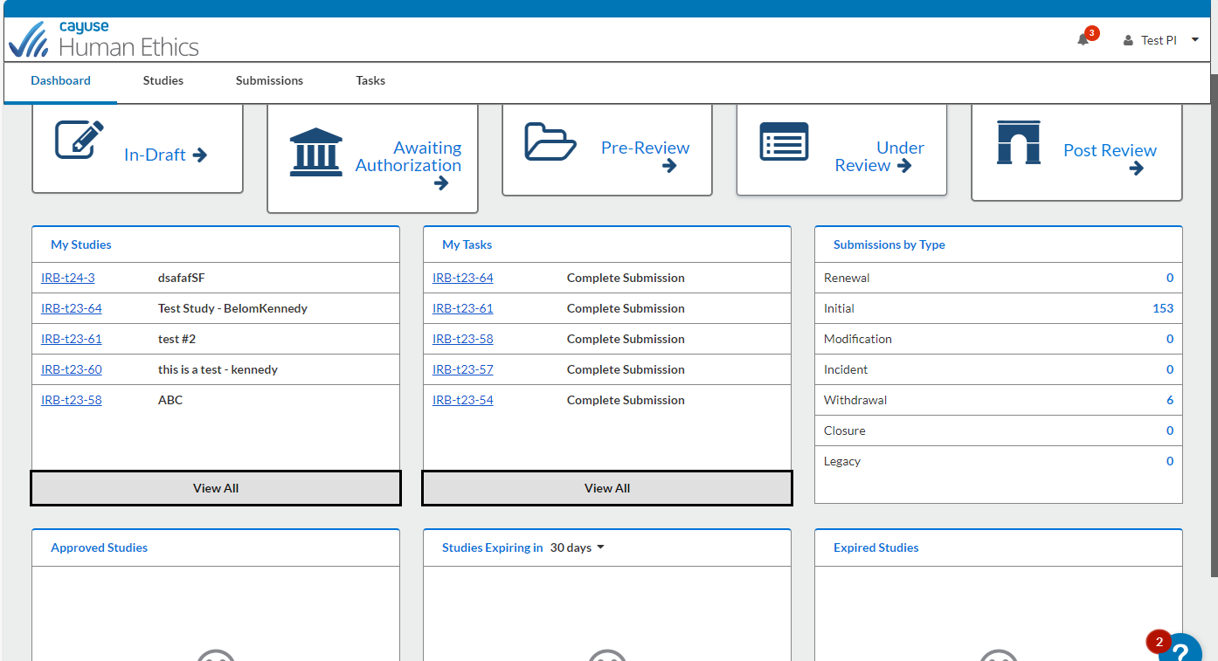
This is your Dashboard where you can navigate all your affiliated studies

Slide 8
Table of Contents
Creating and Submitting a Renewal…………………………………………………………………………….6
Creating a Modification (Amendment)……………………………………………………………………..17
Changing a Study Title………………………………………………………………………………………………26
Submitting an Incident Report and Study Closure…………………………………………………….28
Withdrawing a Study………………………………………………………………………………………………..31

Slide 9
Institutional Review Board
Creating and Submitting a Renewal

Slide 10
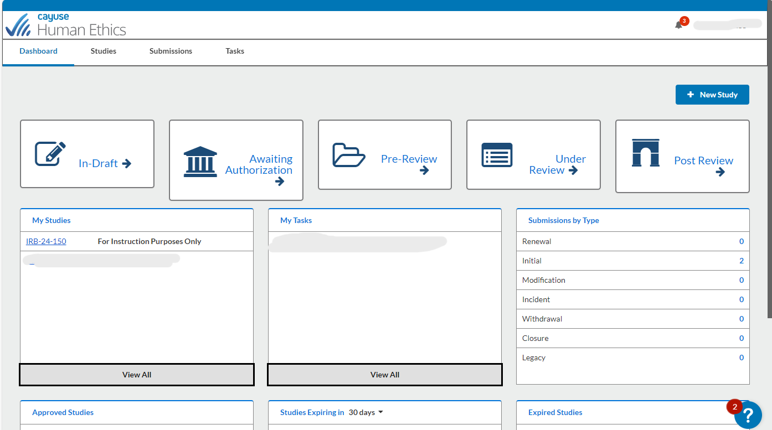
Click on the study you wish to renew under “My Studies”

Slide 11
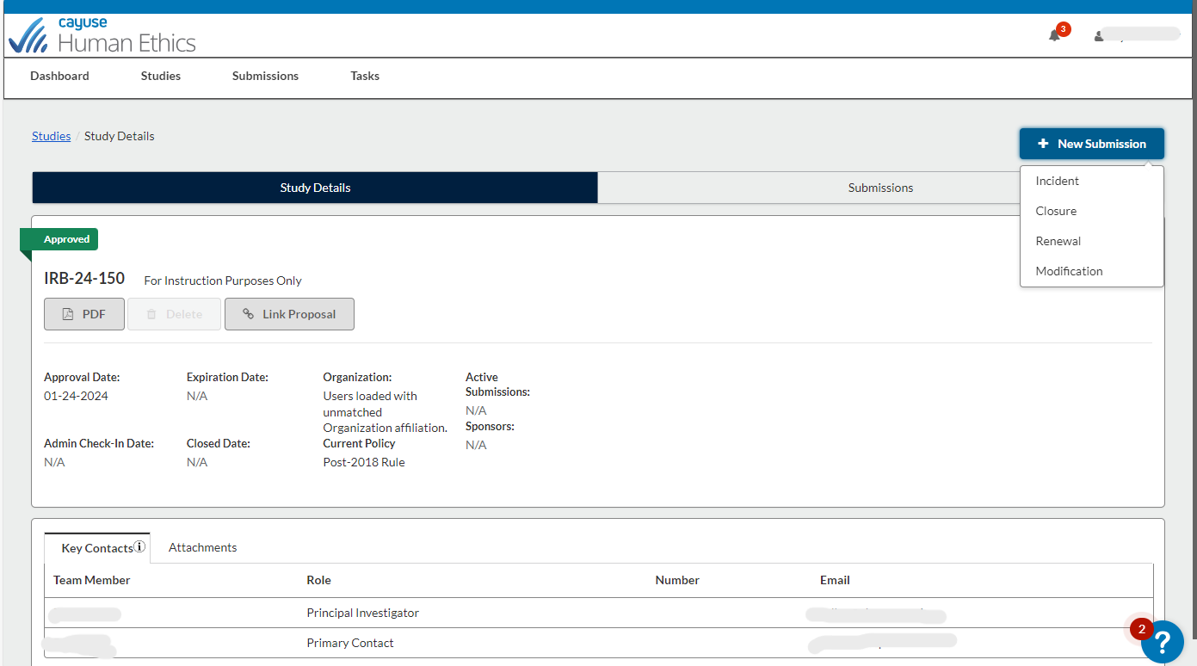
Select Renewal as the type of submission you want to pursue
Renewal: extending the study for up to a year, before the approved protocol expires to only studies that have an expiration date.

Slide 12
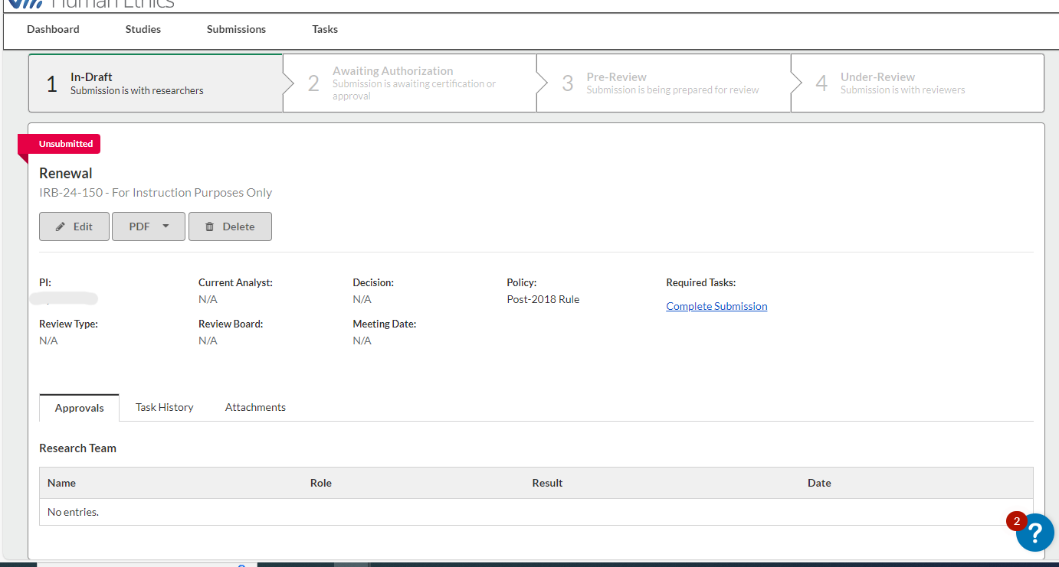
Click “Edit” to begin working on the Renewal

Slide 13
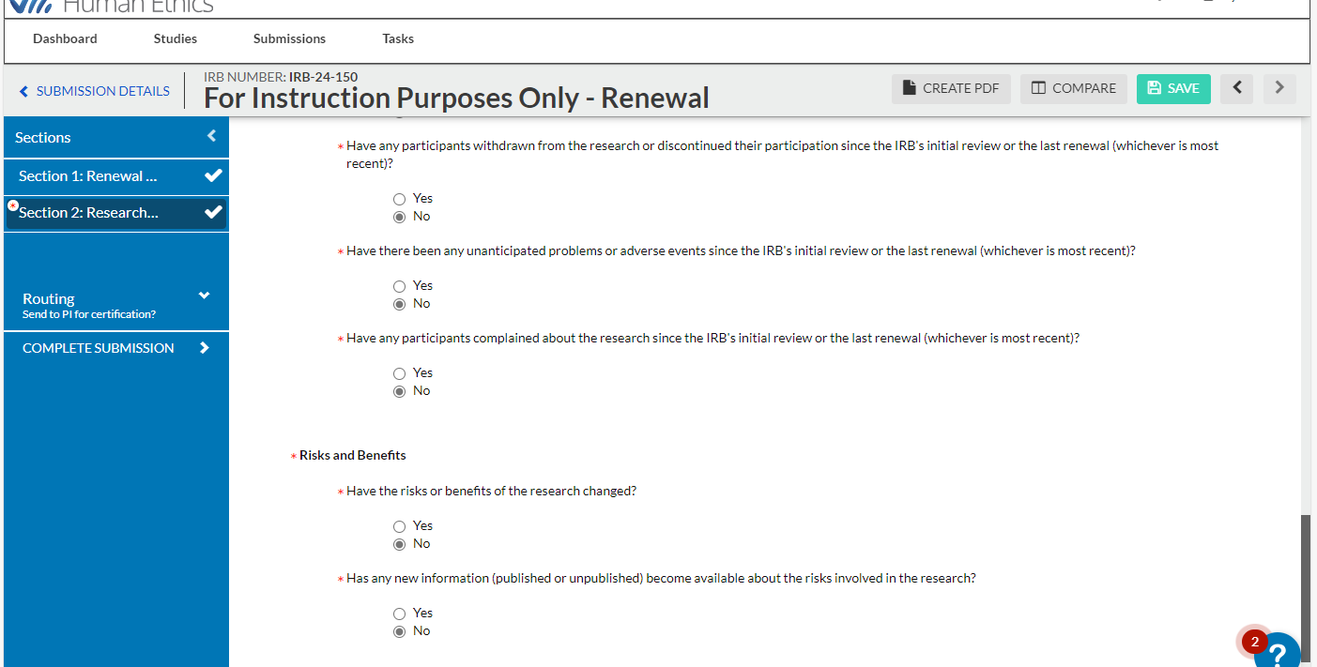
Please answer and complete all the required sections. Once all required (*) are complete, then a checkmark will appear to mark completion
Make sure to Save your work if leaving the submission page
Questions with a red asterisk are required
This protocol is not the same as the initial protocol! Adjust as needed!

Slide 14
Click on “Complete Submission” to send the submission to the PI to certify. This option will not appear until all sections are complete
Submitted Renewals are scheduled to be approved as close to the expiration date as possible

Slide 15
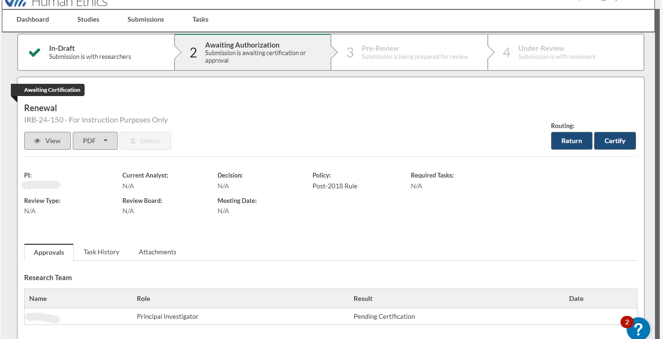
This prompt will appear until the PI, Co-PIs or Org. Approvers (if applicable) have completed certifying. Only then will the study move to pre-review
The PI must certify the submission for it to be submitted to the IRB and if applicable, Organizational Approvers must approve the submission
You will need to Certify each time you submit revisions, renewals, and amendments. Certification says you knowingly mean to take this action (to renew, amend/modify, or close).

Slide 16
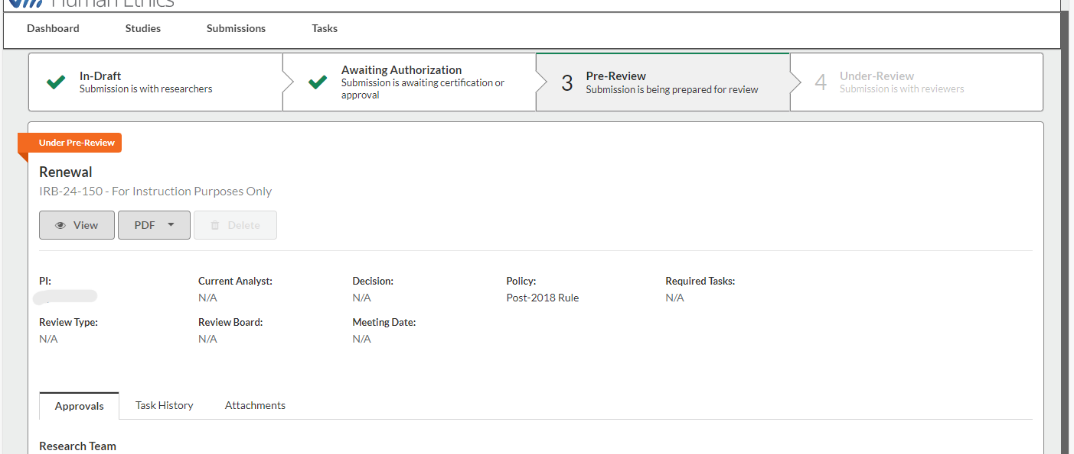
After you have certified, the submission details page should look like this. The study protocol is now “Under Pre-Review” which means it’s with the IRB office. You and any co-PIs should receive an email confirmation of the action and submission type you did.

Slide 17
Institutional Review Board
Creating a Modification (Amendment)

Slide 18
Click on the study you wish to renew under “My Studies”

Slide 19
Select Modification as the type of submission you want to pursue
Modification: submitting a change or amendment to the protocol. Only one Modification can be open at a time. Once approved, you may submit additional Modifications

Slide 20
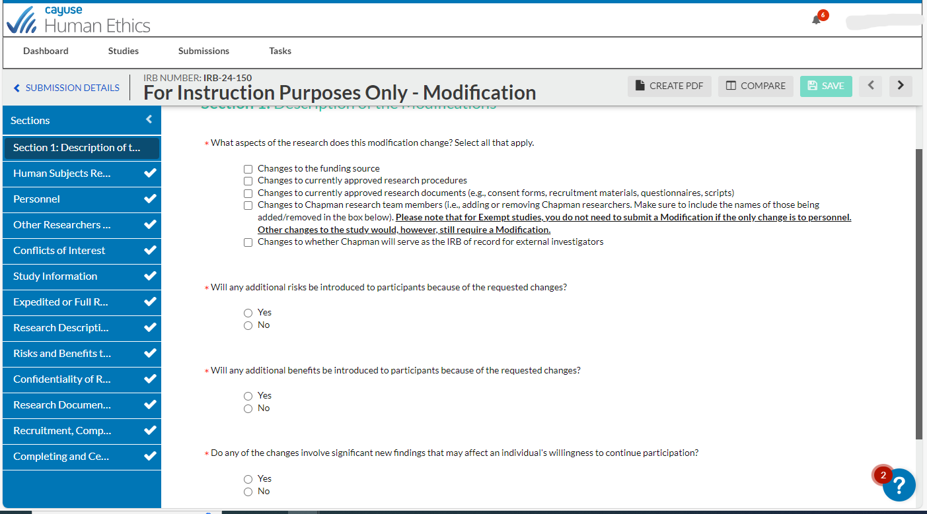
Check off all items that are being changed.

Slide 21
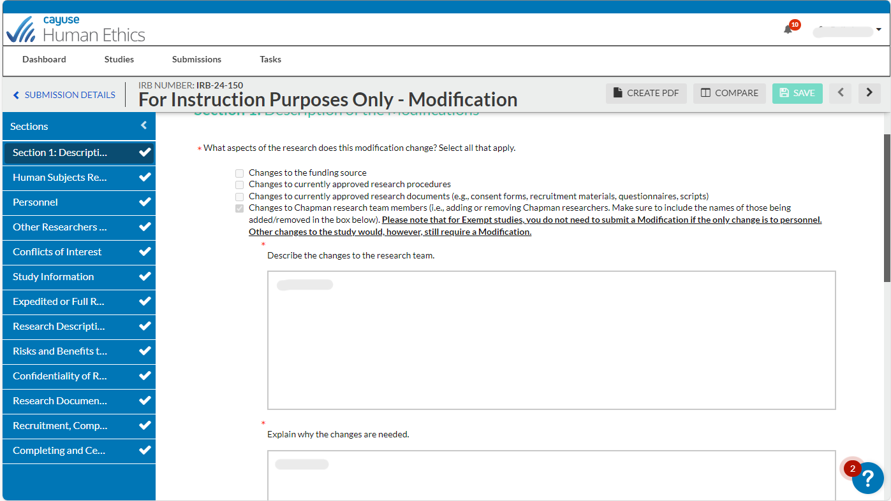
Make sure to accurately describe and explain the changes and state exactly where the changes will be made

Slide 22
Depending on what those changes are, make the applicable changes in each section. This could include changes in “Personnel”, “Research Descriptions,”, “Research Documents,” etc.

Slide 23
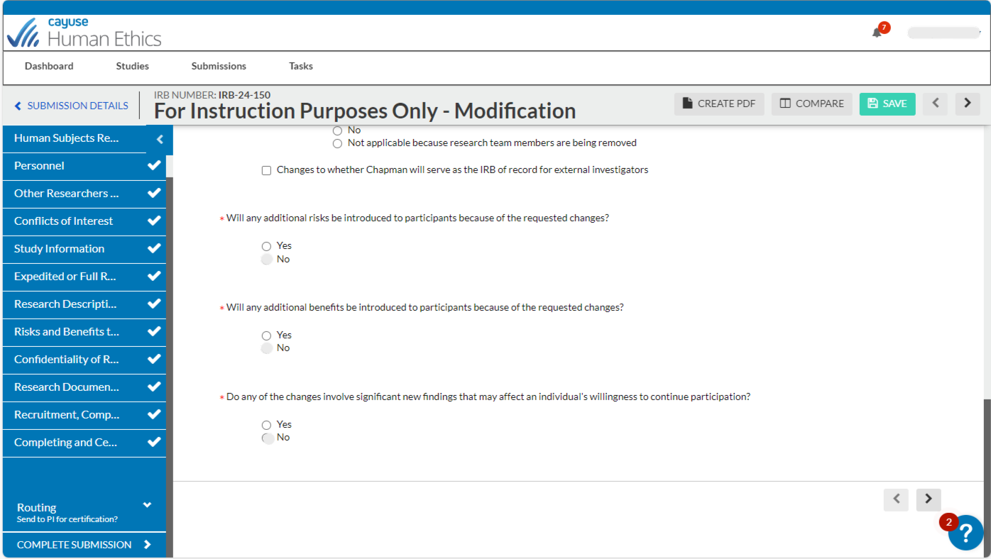
*DO NOT DELETE ANY DOCUMENTS THAT ARE STILL BEING USED*
Only upload documents that have changes. Please include the date in the file name
When all information has been updated, click “Complete Submission” to submit to PI for certification

Slide 24
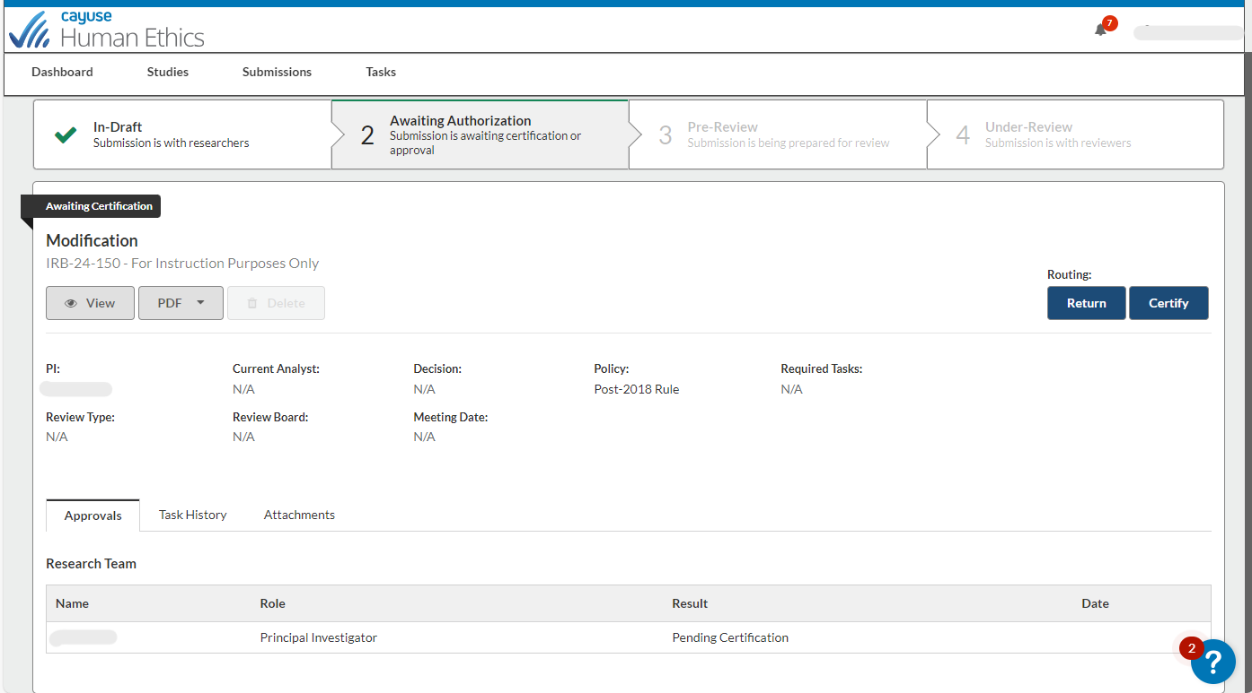
This prompt will appear until the PI, Co-PIs or Org. Approvers (if applicable) have completed certifying. Only then will the study move to pre-review
The PI must certify the submission for it to be submitted to the IRB and if applicable, Organizational Approvers must approve the submission

Slide 25
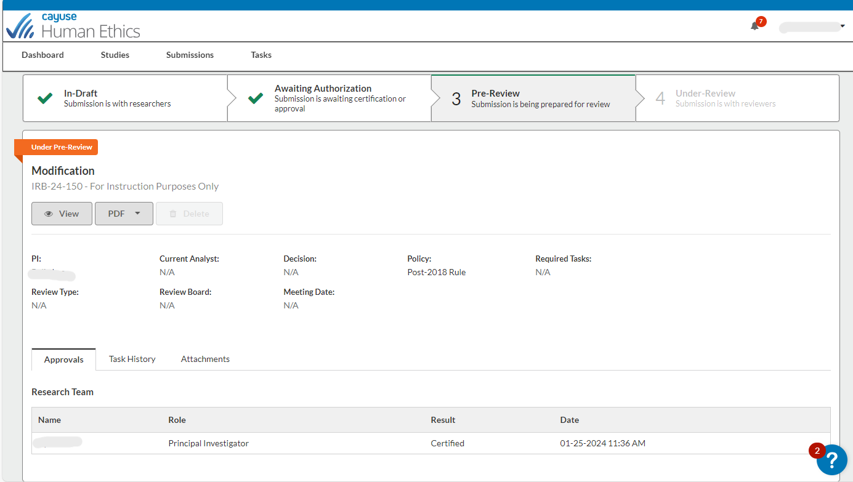
After you have certified, the submission details page should look like this. The study protocol is now “Under Pre-Review” which means it’s with the IRB office. You and any co-PIs should receive an email confirmation of the action and submission type you did.

Slide 26
Institutional Review Board
Changing a Study Title

Slide 27
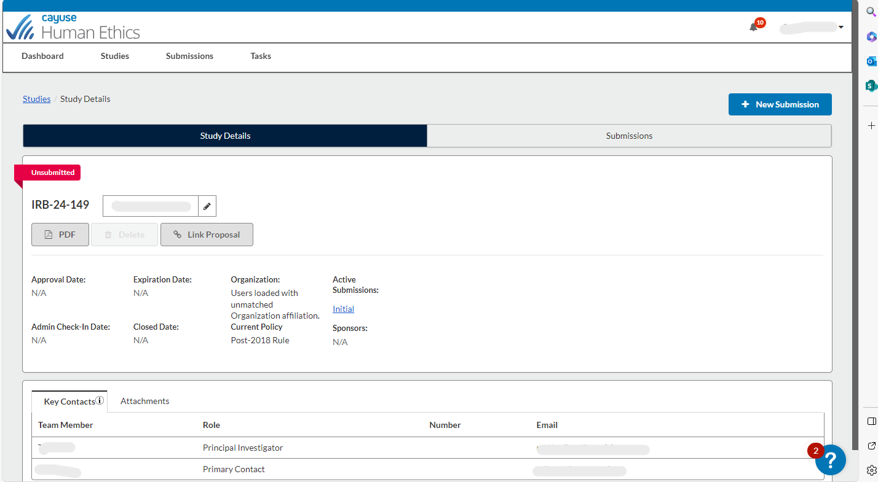
You are only able to change the study title of an initial submission, prior to when it has been approved.
After select your study from the dashboard, hover your cursor over the title on the Study Details page. Clicking in that text box should allow the study title to be edited. After making any edits, the change will need to be saved by selecting the blue checkmark that appears immediately below that field.

Slide 28
Institutional Review Board
Submitting an Incident Report and Study Closure

Slide 29
Select Incident or Closure as the type of submission you want to pursue
Incident: reporting an adverse event or unanticipated problem
Closure: you are finished collecting data for the study

Slide 30
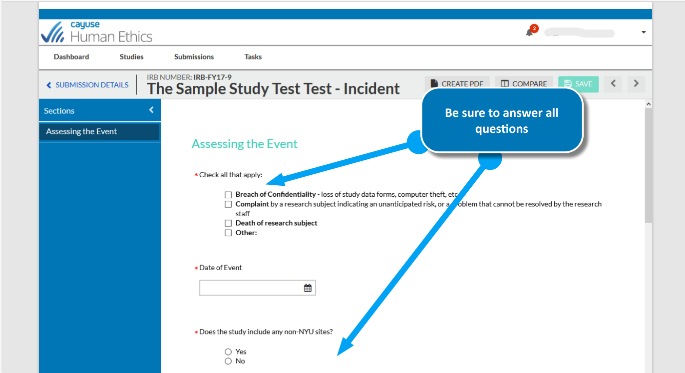
Be sure to answer all questions
Follow the same steps of Certifying the study and Completing the Submission once all required sections have been completed

Slide 31
Institutional Review Board
Withdrawing a Study

Slide 32
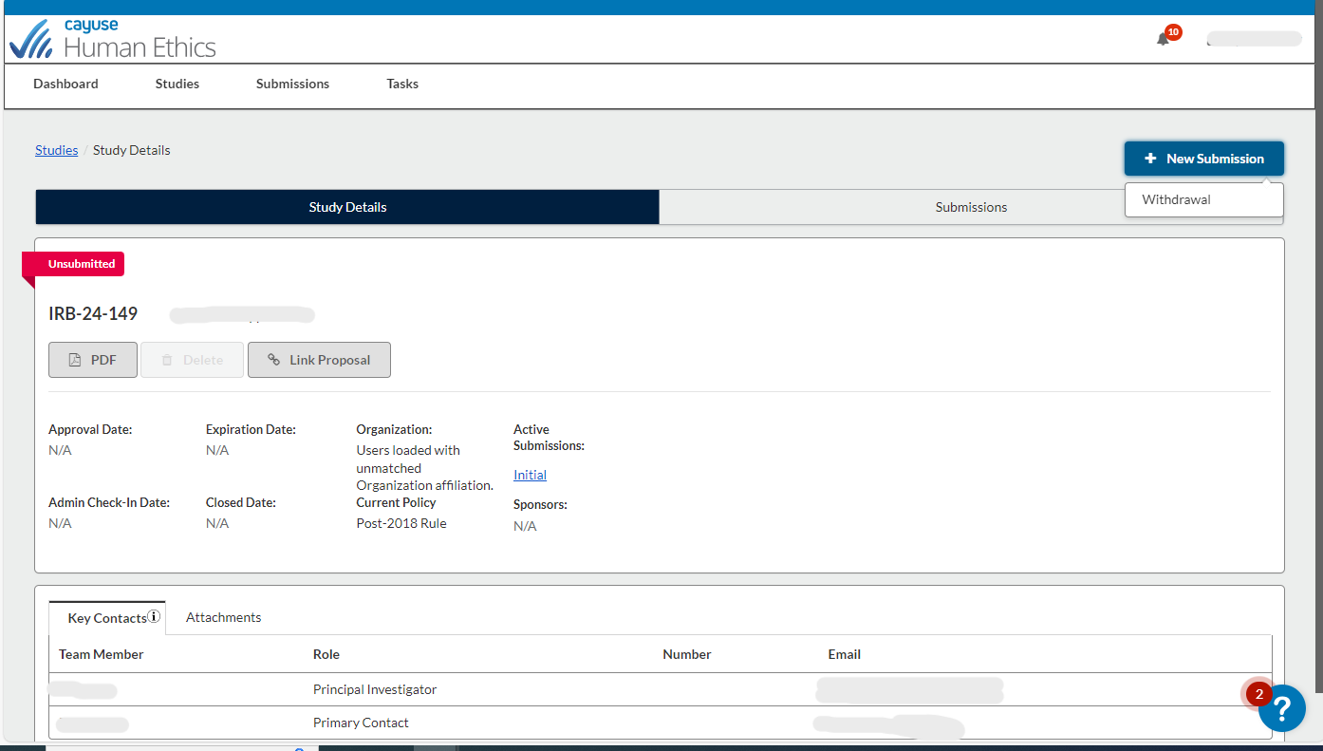
Select Withdrawal to proceed
Withdrawals can be made if you no longer wish to submit your initial submission and want to withdraw the study. You may withdraw your study at any point once an initial submission has been created, until it has been approved

Slide 33
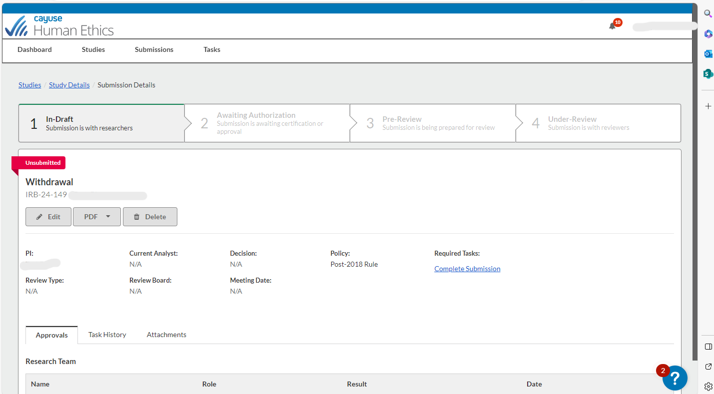
Click “Edit” or “Complete Submission to begin continue withdrawing your study

Slide 34
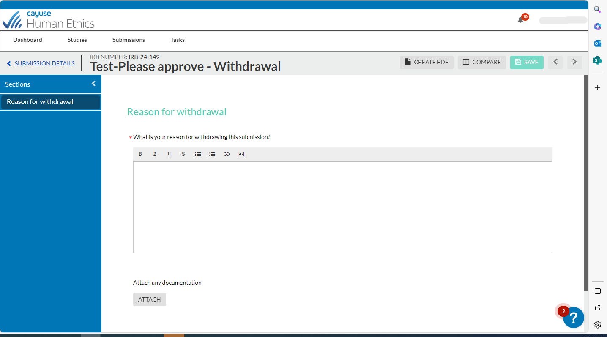
State your reasons for withdrawing and attached any needed documents. When finished, “Complete Submission” will appear on the bottom and follow the same steps to complete the submission to proceed.

Slide 35
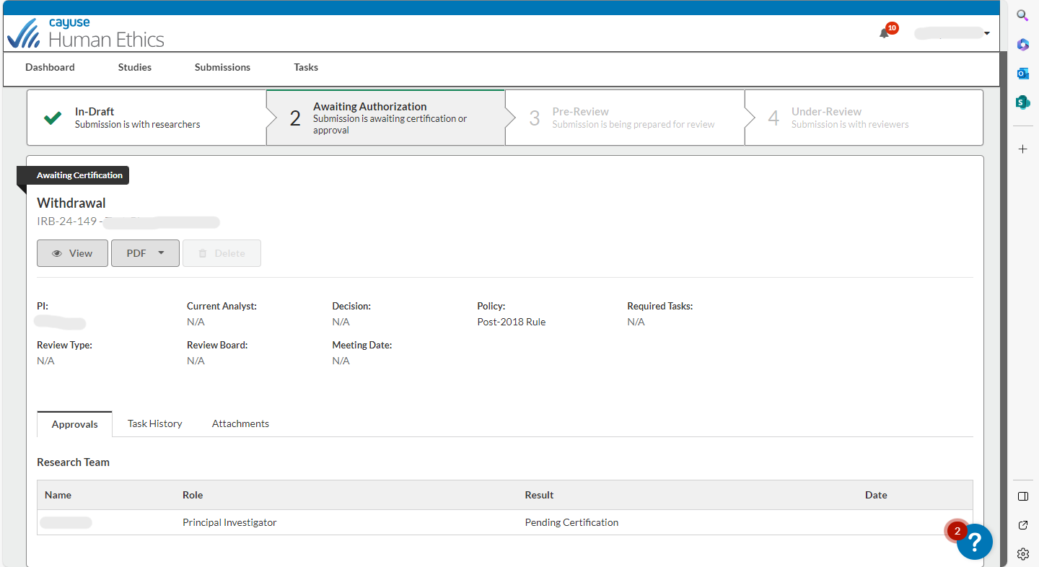
The PI and any other Org. Approvers/Co-PI’s will need to certify the withdrawal before the withdrawal will be complete

Slide 36
If you have any issues or questions, please contact the IRB Office: irb@chapman.edu or (714) 628-2833 and for IRB Consent Templates and links, visit our website at https://www.chapman.edu/research/integrity/irb/forms-and-instructions.aspx
As this is a new IRB system, if you find any issues (typos, unclear questions, etc.) please let us know!

