Slide 1
Cayuse IRB
Submitting a New IRB Protocol

Slide 2
How to use this tutorial
This tutorial is written in the point of view of a Primary Investigator (PI), if you are not a PI, please know that you will need to adjust a few things.
Use your keyboard’s left/right/up/down arrow (or your mouse/trackpad scroll or the spacebar) to move through the PowerPoint. Instructions are animated.
Office of Research INTEGRITY

Slide 3
Before You Begin an IRB Protocol…
Make sure you have the following items ready*:
Supplemental documents in individual document files (i.e. informed consent form(s), authorization(s), recruitment documents, questionnaires, etc.). Files can be in various formats (PDFs, docx) however doc. (Microsoft Word) files are preferred.
Faculty advisor and co-PI(s) CITI training copy of certificate.
Ensure that you and your co-PI(s) have been “authenticated” with the IRB office. If you are unsure, contact the IRB office at irb@chapman.edu
*You do not have to finish the IRB protocol in one sitting. All information can be saved.

Slide 4
After you have been “authenticated” by the IRB office you may log-in to Cayuse
Log in to Cayuse:
https://chapman.cayuse424.com/

Slide 5
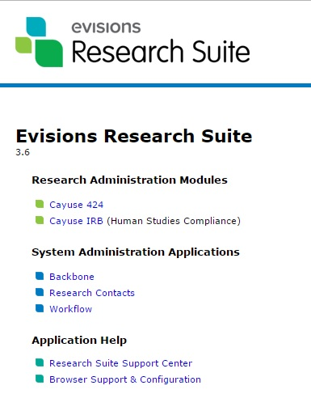
Once logged in, you’re first taken to this page. Click on “Cayuse IRB (Human Studies Compliance)”
Office of Research INTEGRITY

Slide 6
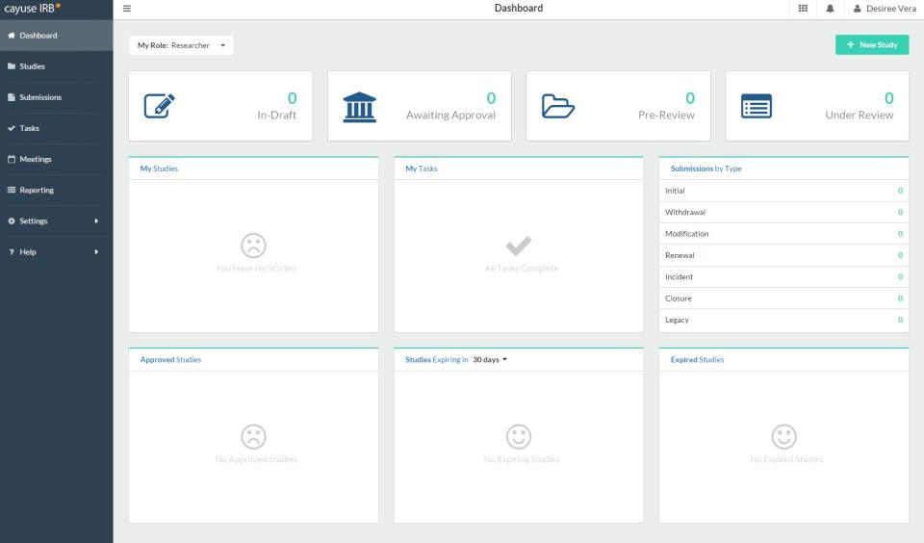
After clicking “Cayuse IRB”, you will be taken to your “Dashboard” where you can see all of your affiliated studies

Slide 7
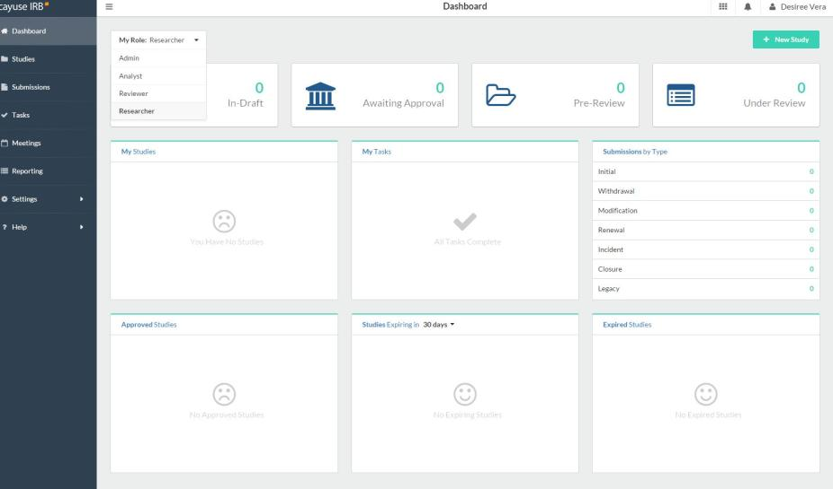
If you are an IRB member, make sure to switch your role to ”Researcher” to submit a new protocol

Slide 8
1. Click on “+ New Study” to begin a new protocol application
2. You will be redirected to another page

Slide 9
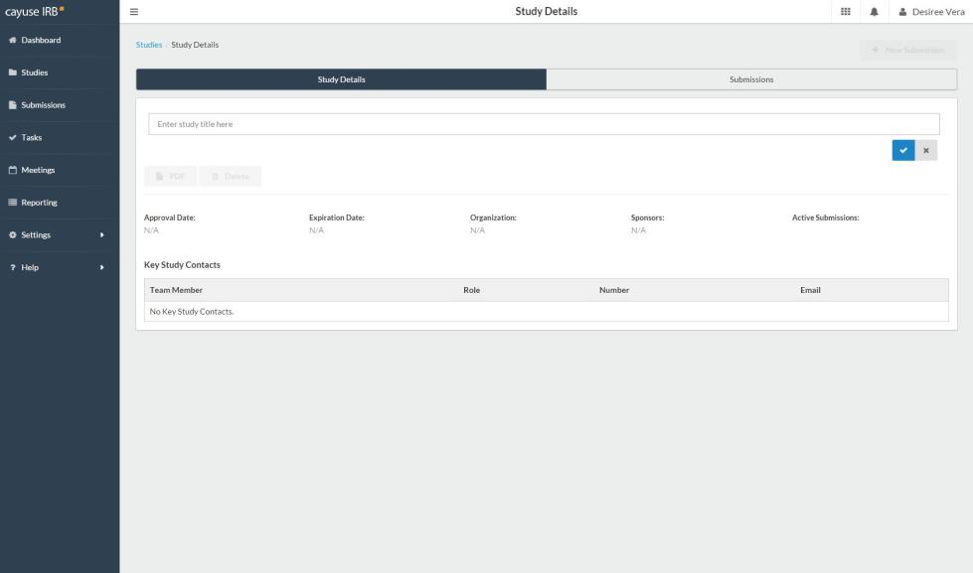
1. Enter the protocol title here
2. Click on the checkmark to move to the next step

Slide 10
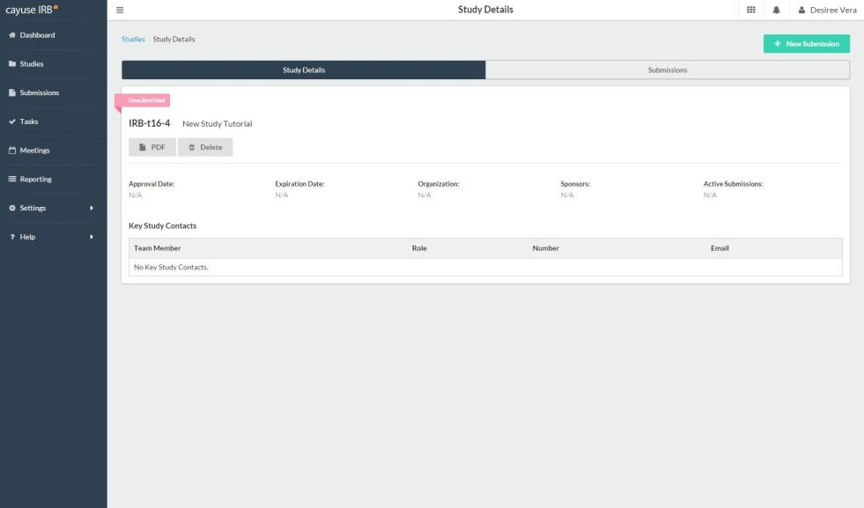
The next step will be to start the IRB protocol. Click “+ New Submission”

Slide 11
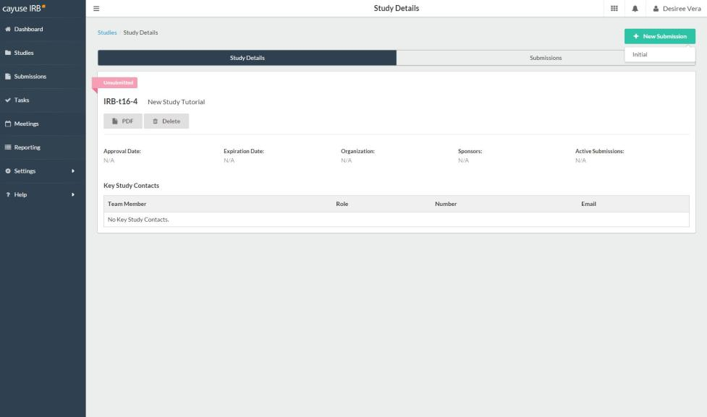
Click on “Initial”

Slide 12
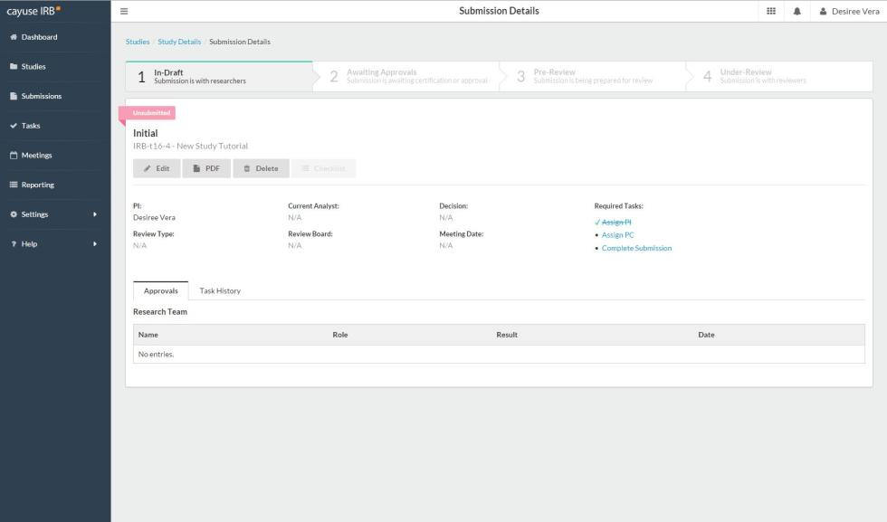
2. Or you can click “Edit” to go directly into the protocol-this is the preferred method.
1. You can check the tasks you need to complete here and you can also click on the tasks to be redirected to that page.

Slide 13
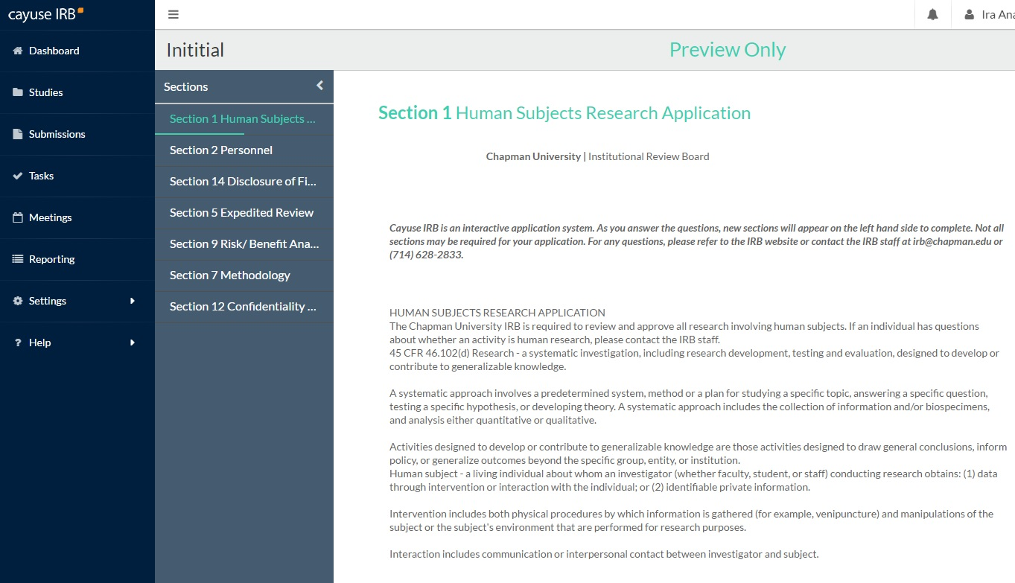
1. Once you select answers on the first page, you will be redirected to the appropriate sections and application questions.
2. These are the sections of the protocol. You can move through any section by clicking on them and your work will be automatically saved.
3. Once a section’s required answers (*)have been answered, a checkmark will appear on the section. All sections must have a checkmark in order to complete final submission.
4. You can also click on this next button to move through the protocol.

Slide 14
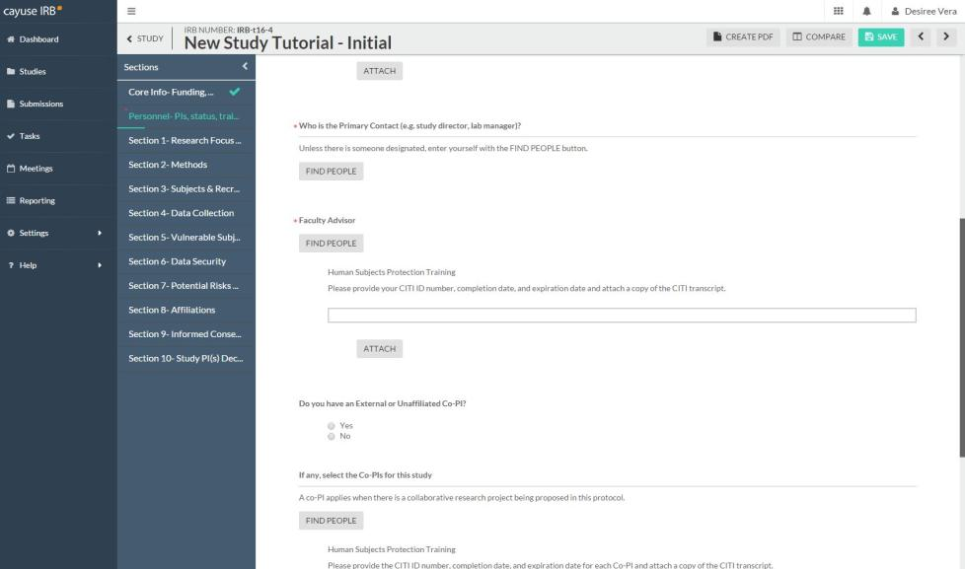
1. For the question “who is the Primary Contact (PC)”, you will enter your name by clicking on the “Find People” button. A small screen will pop up on the screen.

Slide 15
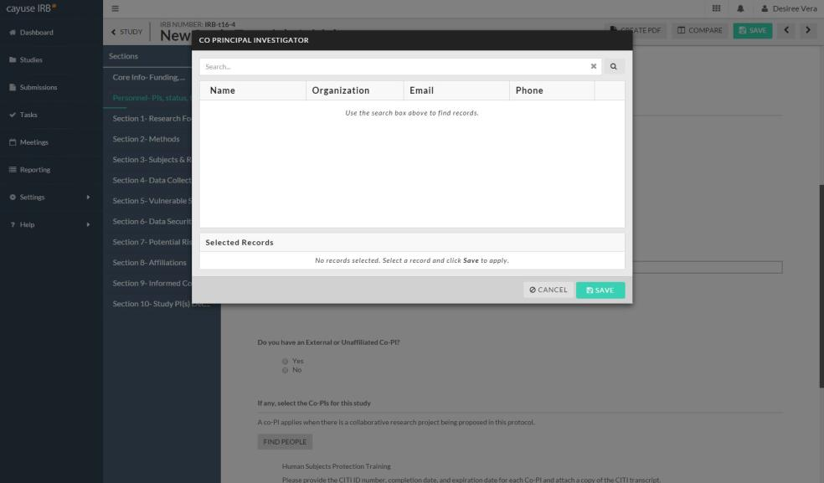
Type in your name and click enter on your keyboard.

Slide 16
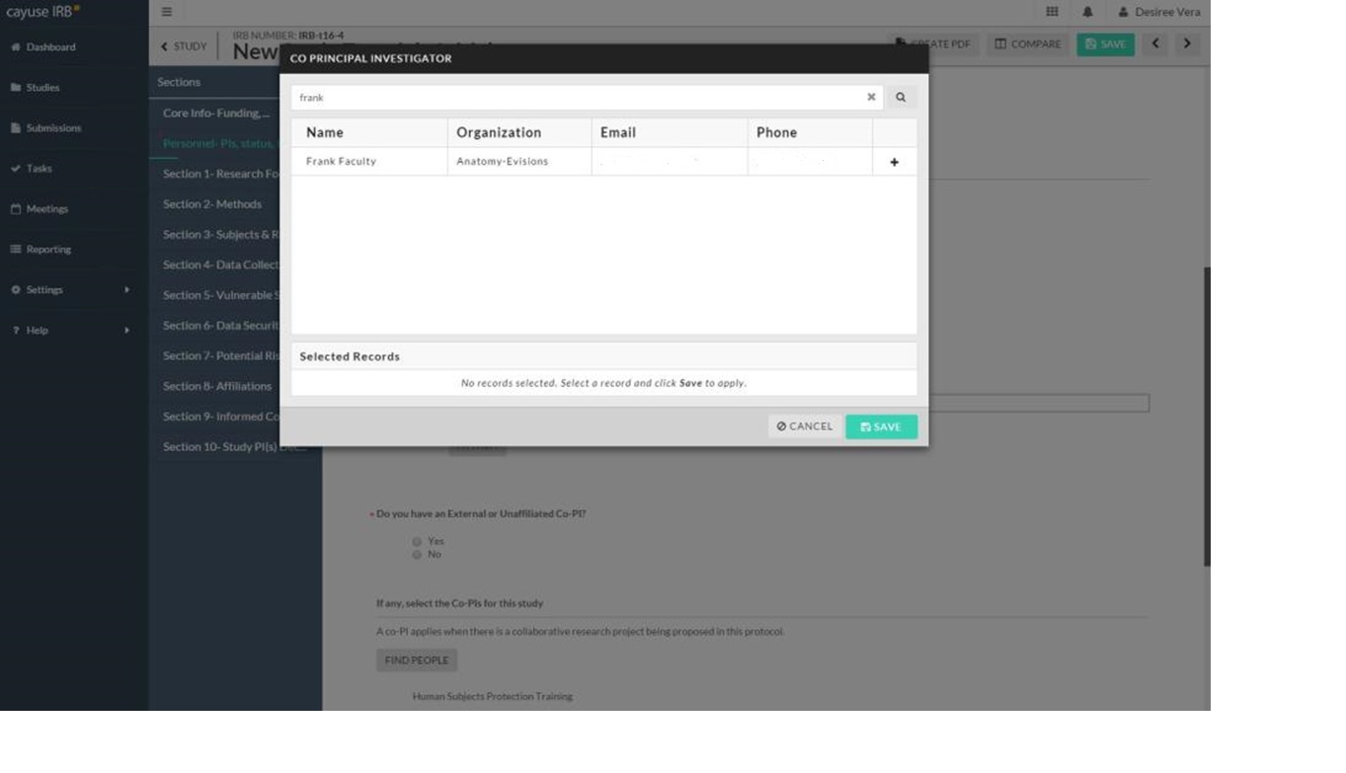
1. Select your name and click “Save”.
2. The same process is needed for faculty advisors and co-PI(s). If you do not find your faculty advisor or co-PI(s) name, please contact the IRB office irb@chapman.edu). They will need to be manually entered into the system which will take 24hrs to become active.

Slide 17
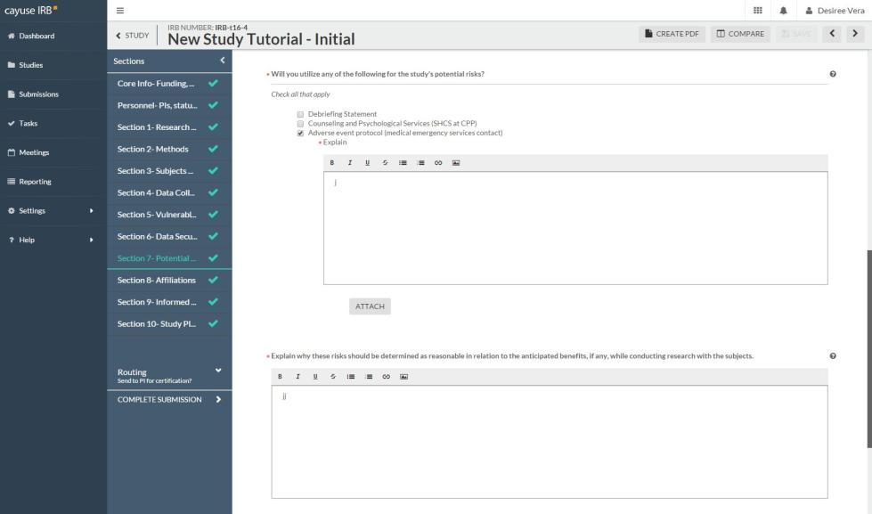
1. Throughout the application you will be asked to attach certain documents
2. Click on “Attach” and a pop up on your screen will appear.

Slide 18
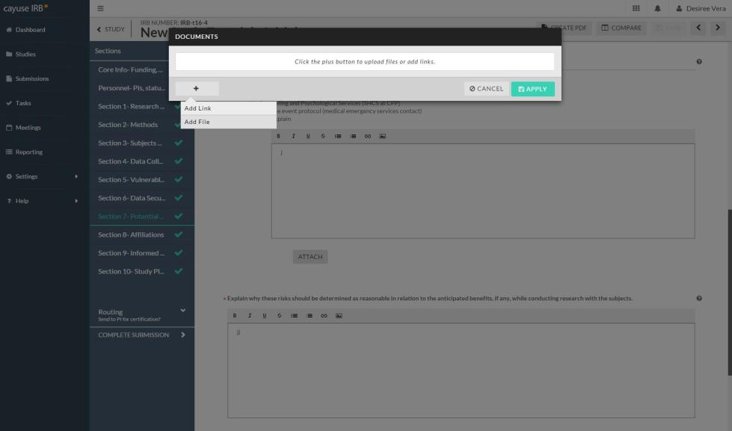
1. Click on the “+” sign to add an attachment.
3. Click “Apply” to attach
2. You can Add Files (Word documents, pdfs, images, etc.) or Add Links

Slide 19
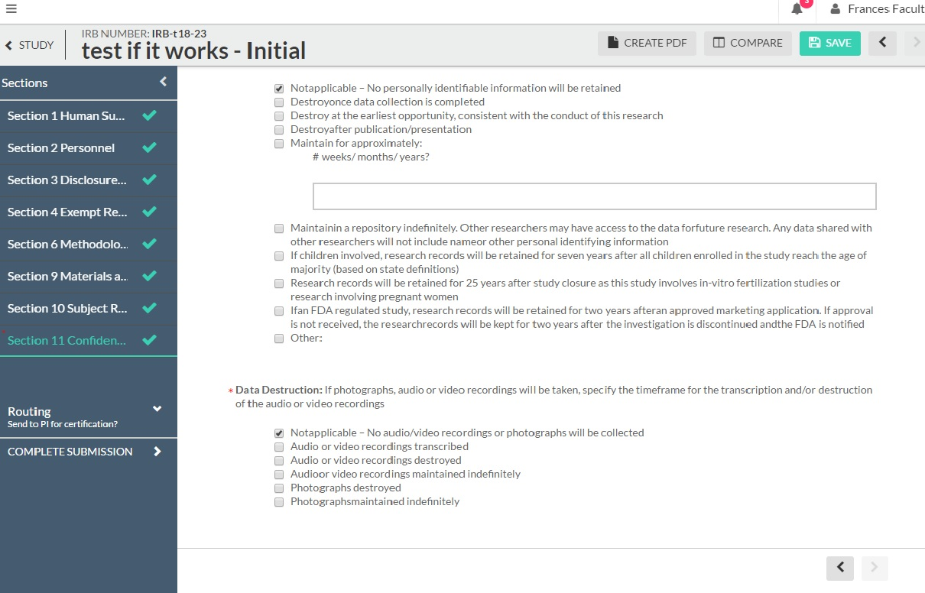
2. You can review your application by clicking through the sections or by creating a PDF version of the protocol.
1. Once all of the sections have been completed (all have checkmarks), and you have reviewed your application, you can submit your application.
3. Click on “Complete Submission” when you are ready. You will be redirected to another page.

Slide 20
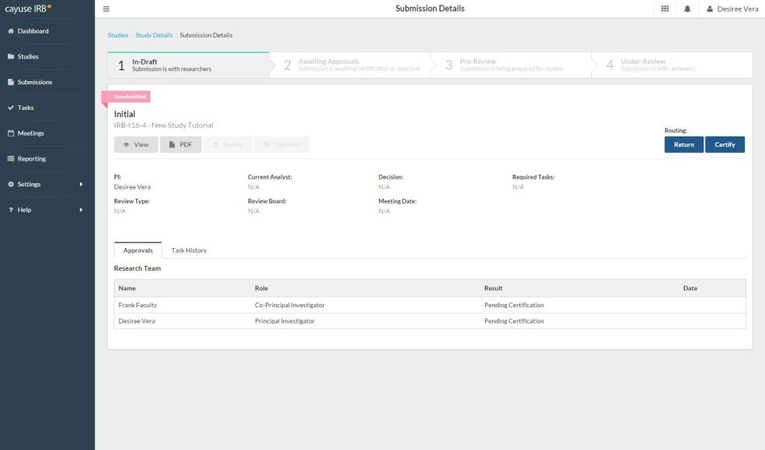
After clicking on the “Complete Submission” button, you will be redirected to this page where you will need to click on “Certify”.
You will need to “Certify” each time you submit revisions, amendments, renewals.

Slide 21
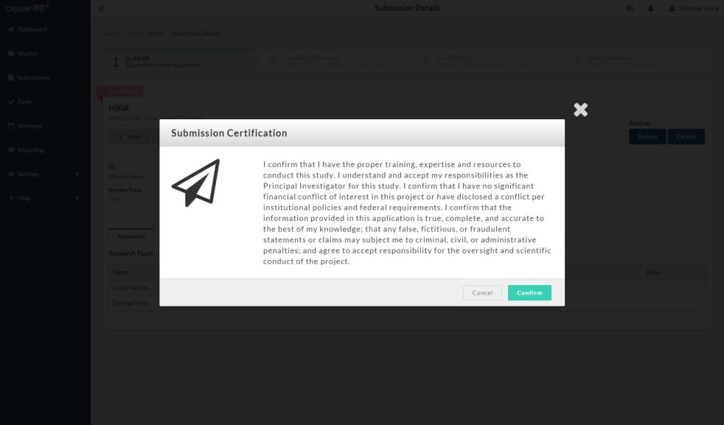
1. Read the Submission Certification and click on “Confirm” if you agree.
2. Selecting “Confirm” will also send your application to the faculty advisor and co-PI(s) that you have listed.

Slide 22
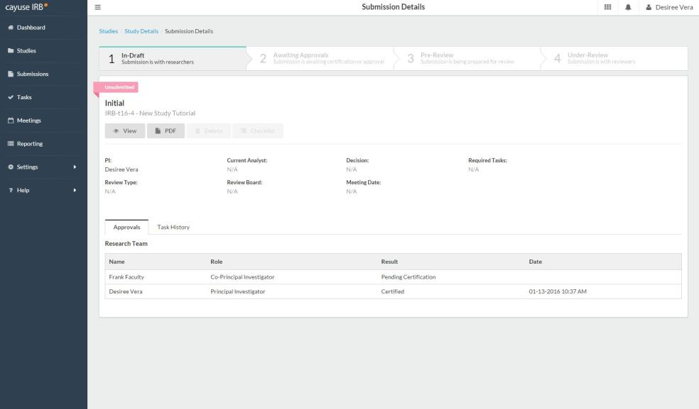
1. Your protocol will remain “Unsubmitted” until your listed faculty advisor or co-PI(s) have logged in and reviewed the application and have “Certified”. They will receive a notification email to do this.
2. Once everyone has “Certified”, the application will be sent to the IRB office to begin the review process.

Slide 23
You can keep track of your studies and where they are in the review process by looking at these sections on your Dashboard.

Slide 24
If you have any issues or questions, please contact the IRB Office: irb@chapman.edu or (714) 628-2833 and for IRB Consent Templates, visit our website at https://www.chapman.edu/research/integrity/irb/forms-and-instructions.aspx
As this is a new IRB system, if you find any issues (typos, unclear questions, etc.) please let us know!

