Slide 1
Institutional Review Board
Cayuse Responding to Comments

Slide 2
How to use this tutorial
This tutorial is for researchers (PIs) who already have an approved IRB protocol and wish to change the study title and submit a renewal, modification, incident (adverse event) or closure.
If the protocol has not been reviewed and approved, then the researchers can submit a withdrawal type protocol. That process is similar to what is described here; the details are at the end of this tutorial.
In Cayuse, the first protocol is known as the “initial” study. It can also be called “de novo,” “new,” “draft” while it is being written and developed, and “under review” by the IRB (both the office and the Board members).
Before approval, PIs can withdraw their protocol from further review. Once approved, then the protocol can be amended/modified, renewed, or closed.

Slide 3
Before Proceeding
This tutorial is written in the point of view of a Primary Investigator (PI)
If you are not a PI, please note that there may be adjustments needed to what your role may be. If you have any questions, please email irb@chapman.edu
*If there are questions that are not answered on this Power Point, please email irb@chapman.edu or check the website for any missing/confusing information
Office of Research Integrity and Compliance v5-2024

Slide 4
Before Beginning an IRB Submission…
Make sure you have the following items ready*:
Supplemental documents in individual document files (i.e. informed consent form(s), authorization(s), recruitment documents, questionnaires, etc.)
Faculty advisor and co-PI(s) CITI training copy of certificate
Follow the steps here: IRB Training and Continuing Education |
Ensure that you and your co-PI(s) have been “authenticated” with the IRB office. If you are unsure, contact the IRB office at irb@chapman.edu
*You do not have to finish the IRB protocol in one sitting. All information can be saved.

Slide 5
Logging In
Login to Chapman’s Cayuse:
Navigate to http://chapman.cayuse424.com/ and sign in with the email that has been authenticated by the IRB. Use your Chapman email and password for easiest pathway

Slide 6
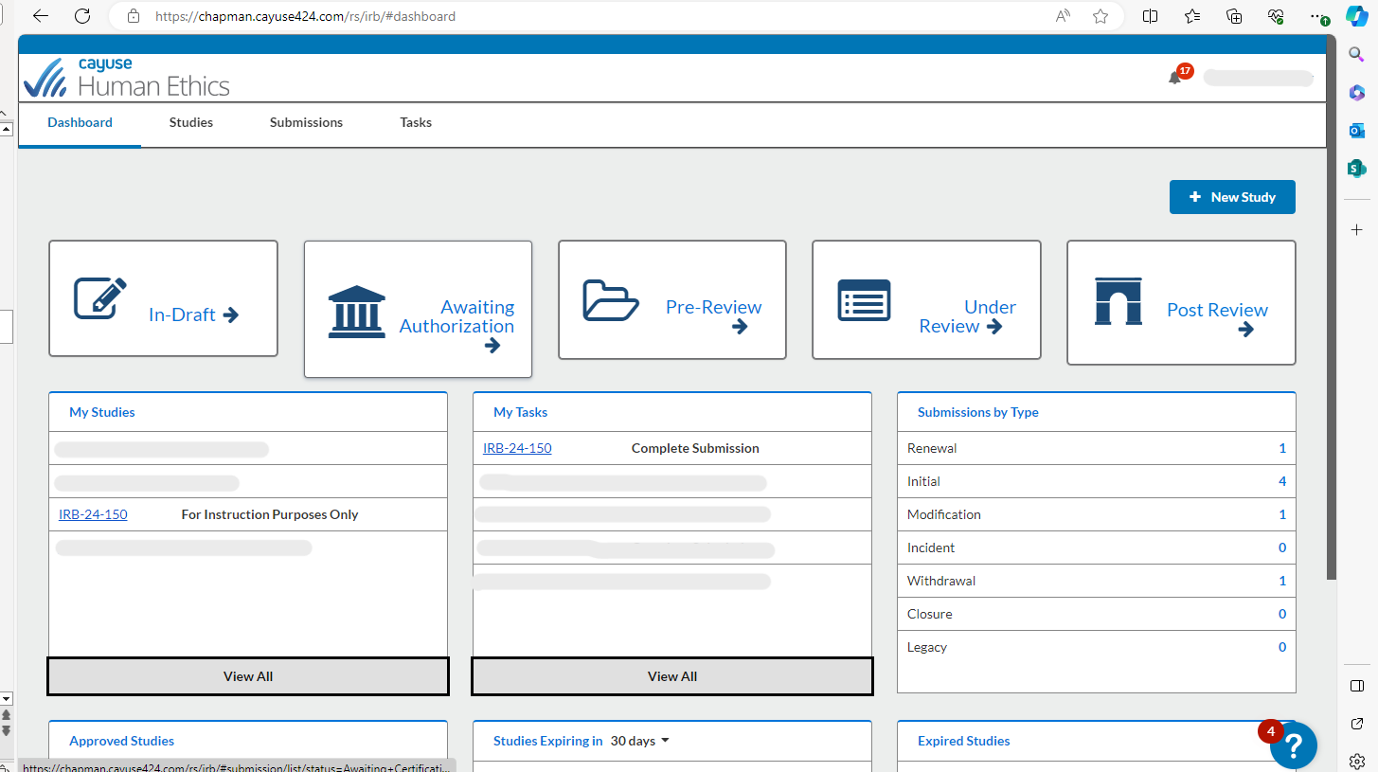
If your study was not initially approved, your submission will be sent back to your dashboard and will be seen under “My Tasks”

Slide 7
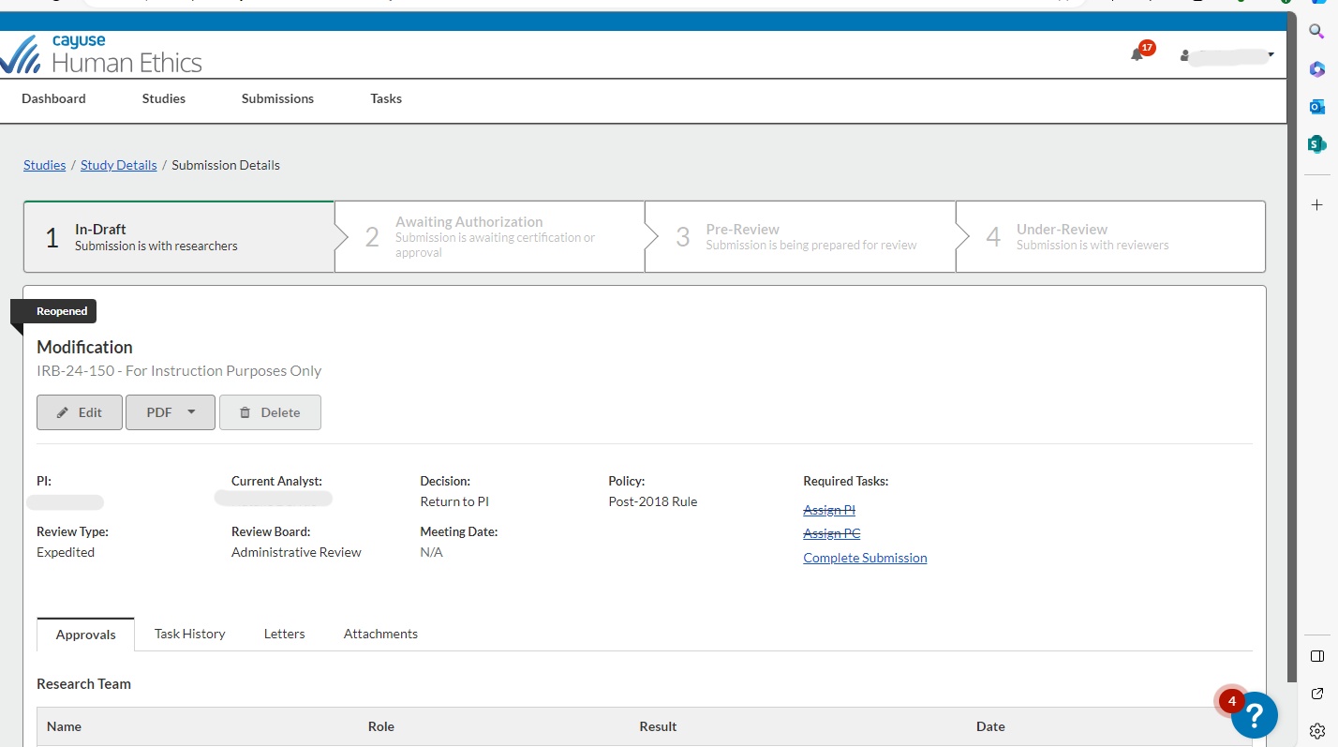
To review comments/edit submission click either “Edit” or “Complete Submission”

Slide 8
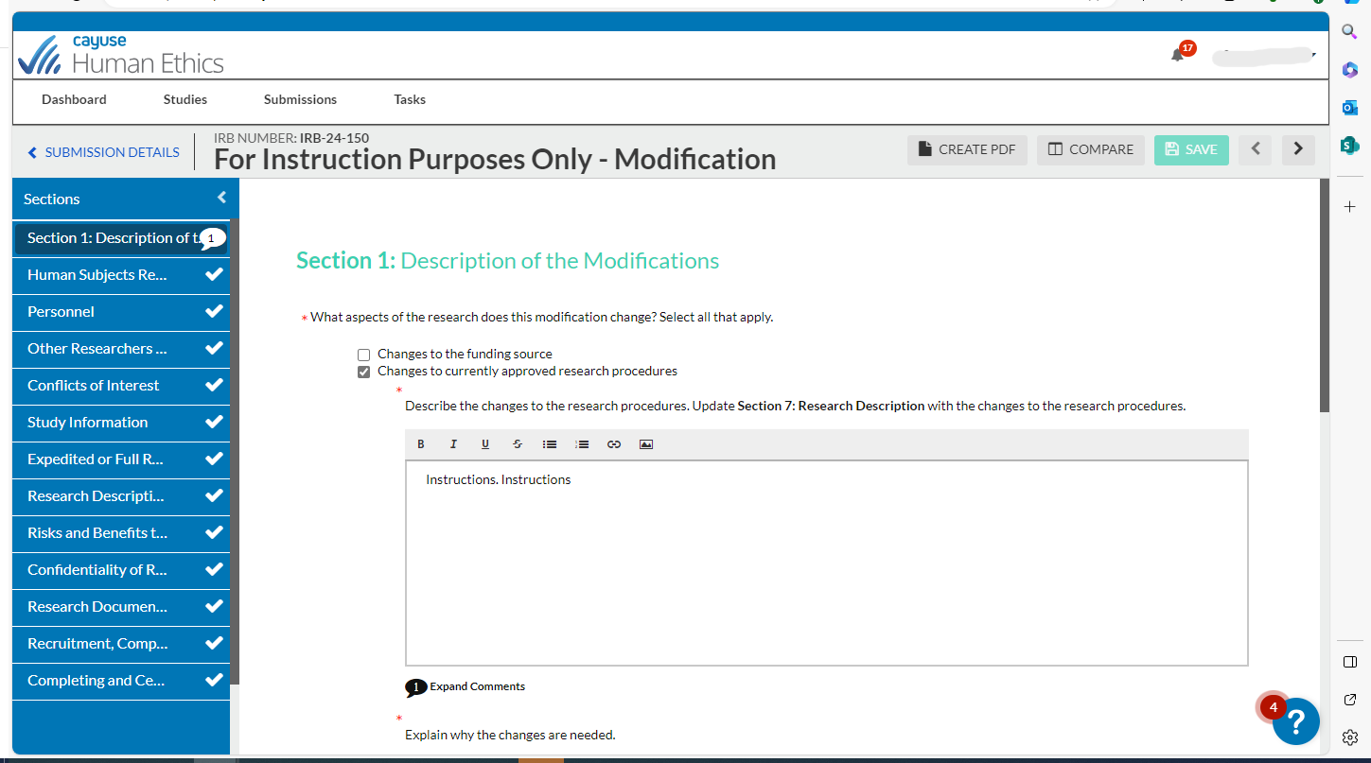
If a reviewer left comments, you will see a comment bubble with the number of comments left in the section.
Click on the section with the comments you want to address and scroll down until you see this:

Slide 9
Click on the speech bubble to expand comments

Slide 10
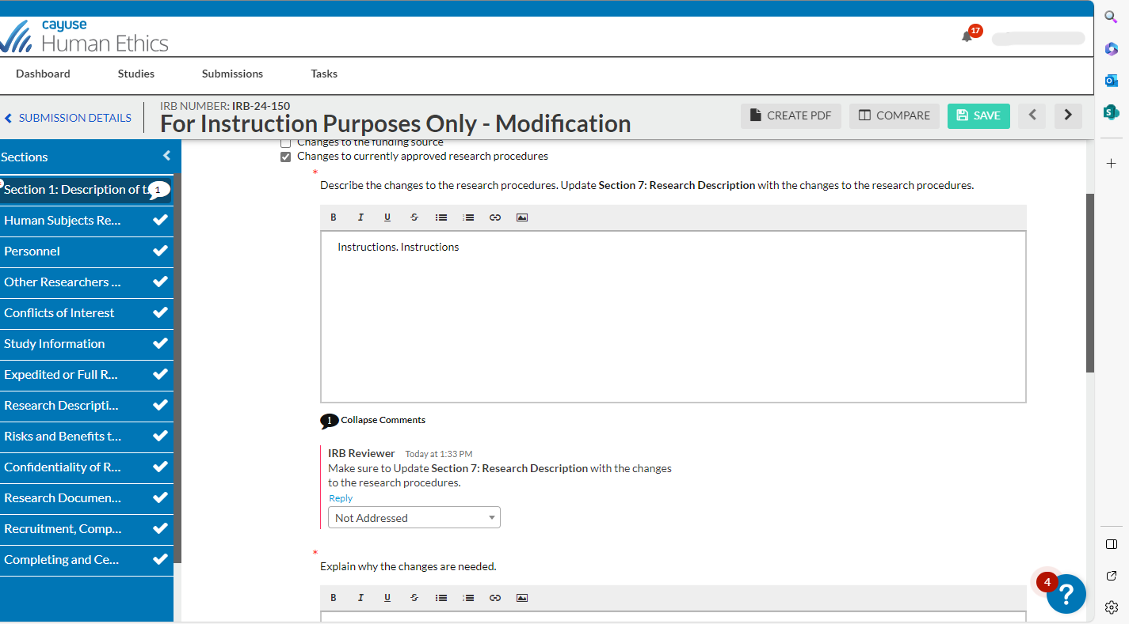
Once you expand the bubble, you will be able to review the comment. You can choose to reply to the comment with your answer, a question, or an action

Slide 11
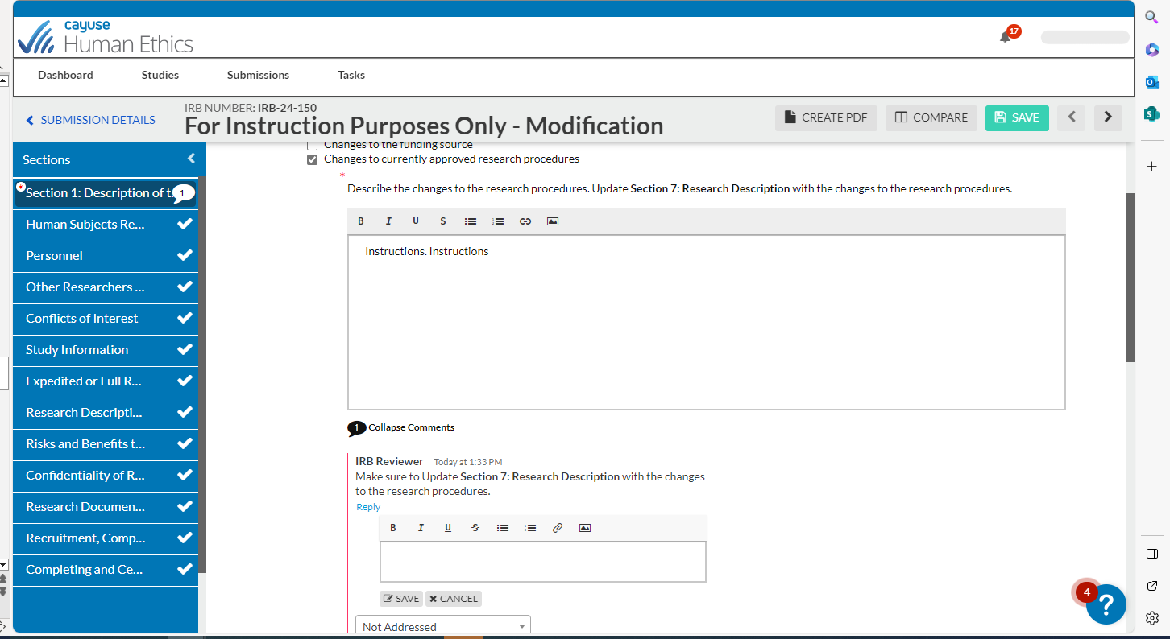
When making changes to your answers, please make sure to Bold the new information so that the reviewers can easily see the changes.
This box will pop up once you click “Reply.”

Slide 12
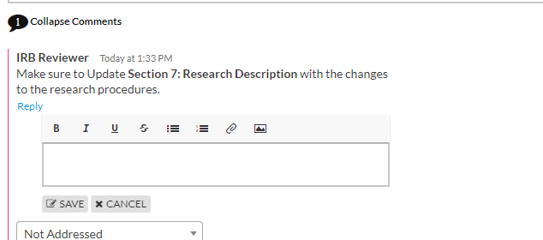
You NEED to save the comment every time!

Slide 13
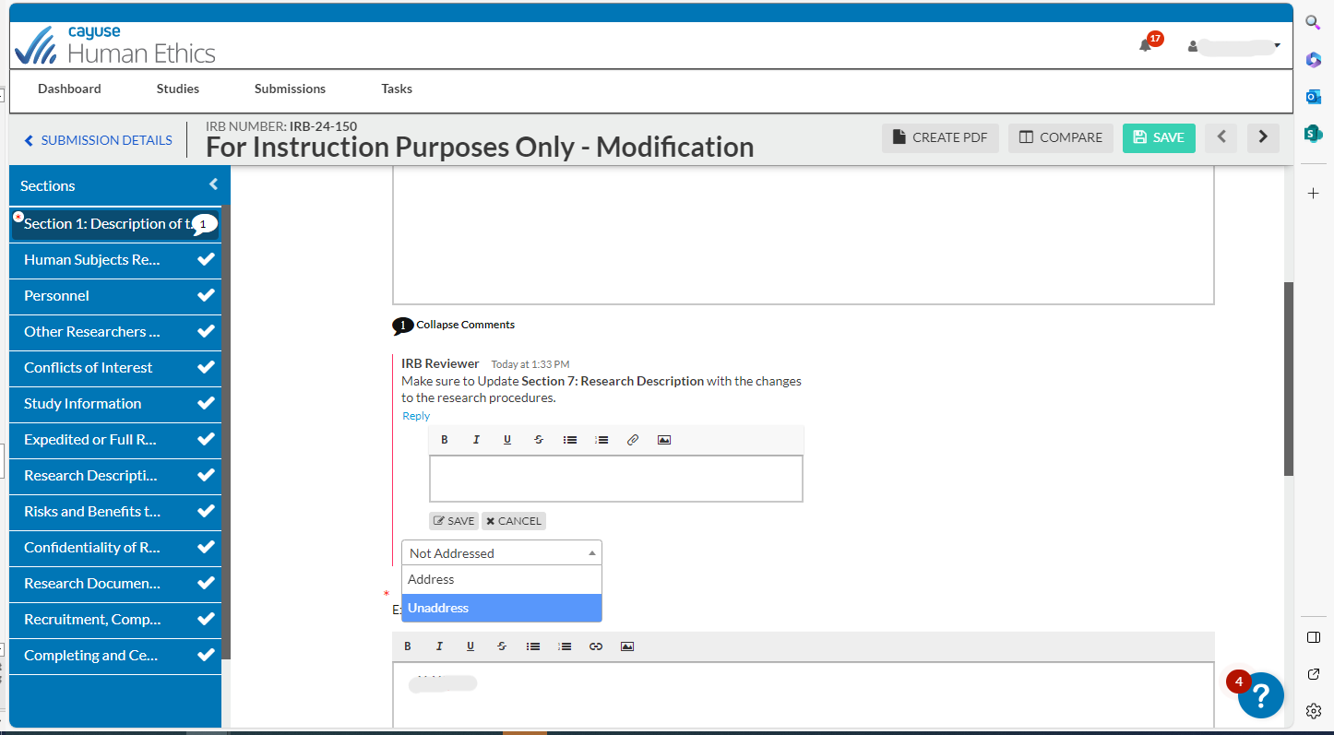
Once you have either replied or made the changes requested in the comment PLUS saved your comment. You will need to address your comment. The default is “Not Addressed,” so you will need to select “Address” to proceed with the submission
Click the toggle “Not Addressed” and these two options will appear. Select the one that matches your appropriate actions.

Slide 14
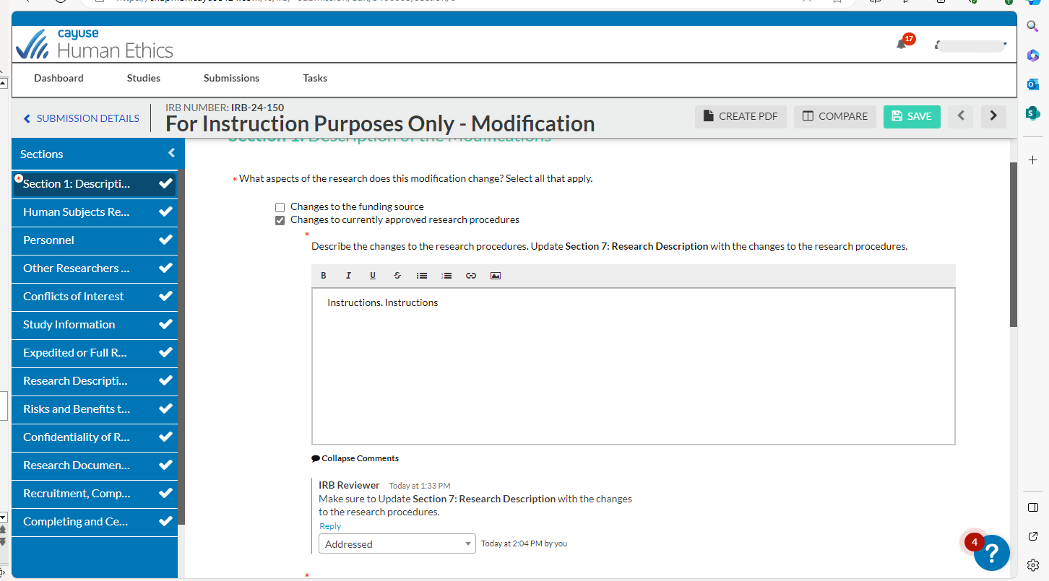
If all comments have been addressed in the section, the comment bubble will become a check mark
After addressing the comments and selecting “Addressed,” the comment will look like this.

Slide 15
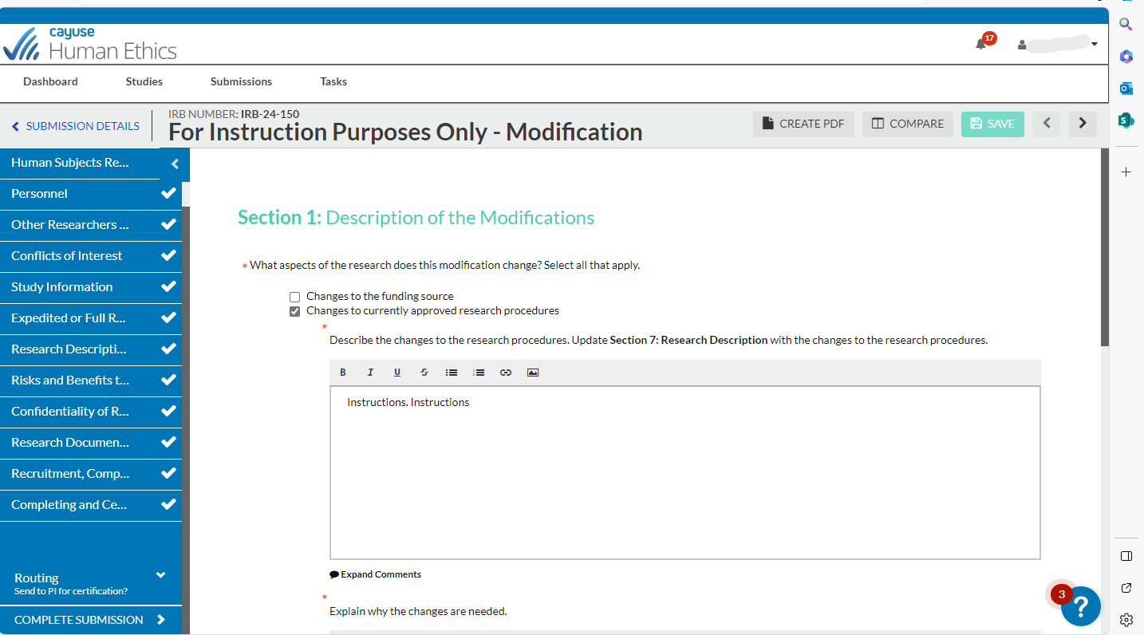
Once all comments have been addressed, select “Complete Submission” and follow the steps of certification to send over the modification for review.

Slide 16
If you have issues or questions, please contact the IRB Office at irb@chapman.edu or (714) 628-2833 and for IRB Consent Templates and Forms, visit https://www.chapman.edu/research/integrity/irb/forms-and-instructions.aspx
Please let us know if you find any issues (e.g., typos, unclear questions), as this is a new system. Thank you.

